Slide 1
Data alignment for the comparison of functional data in series
Lecture Title

Slide 2
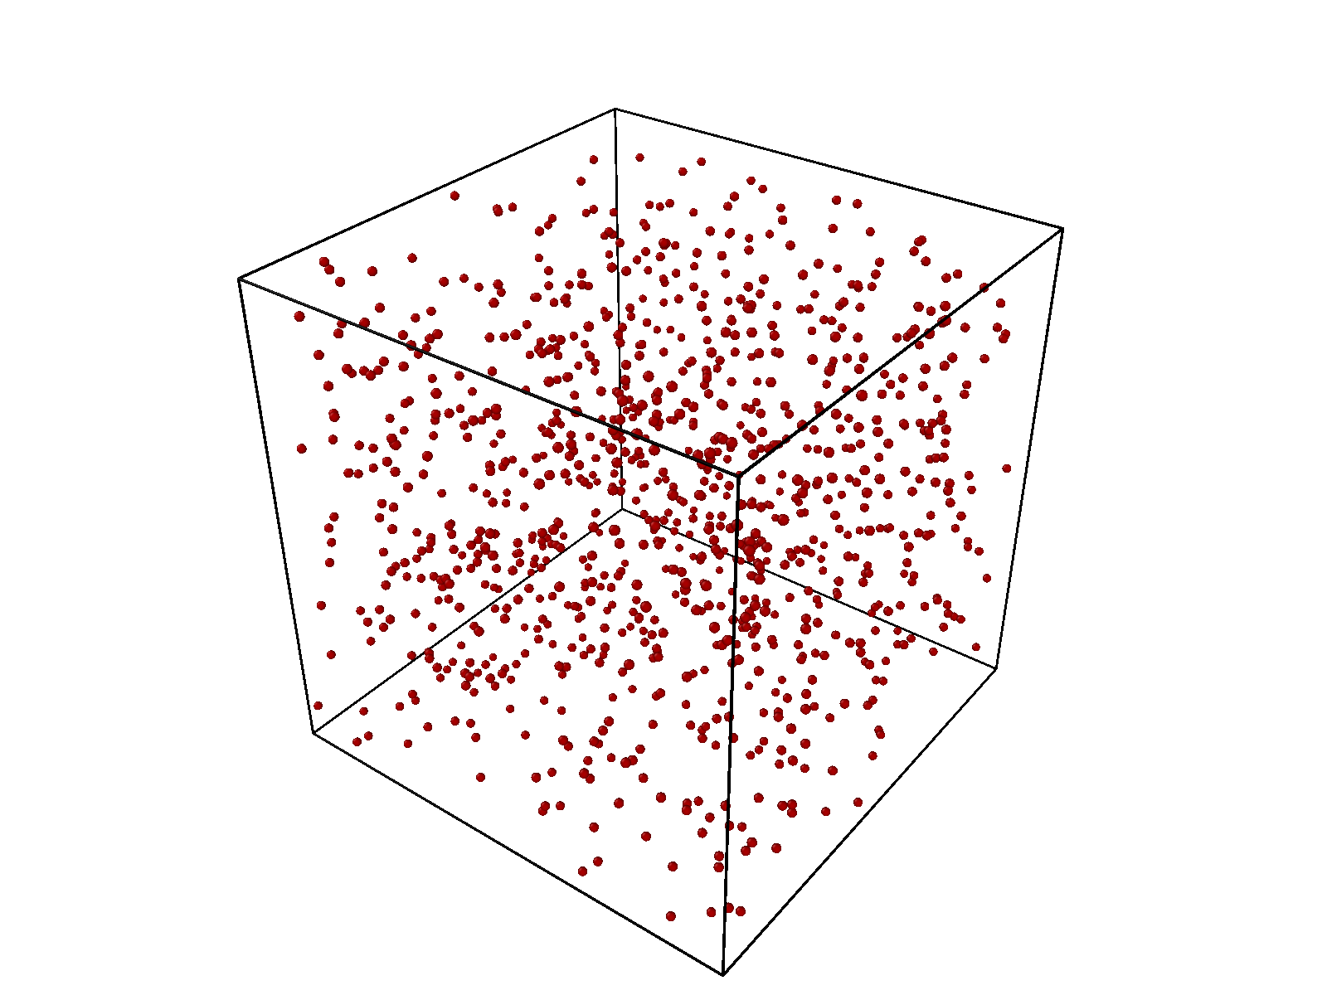
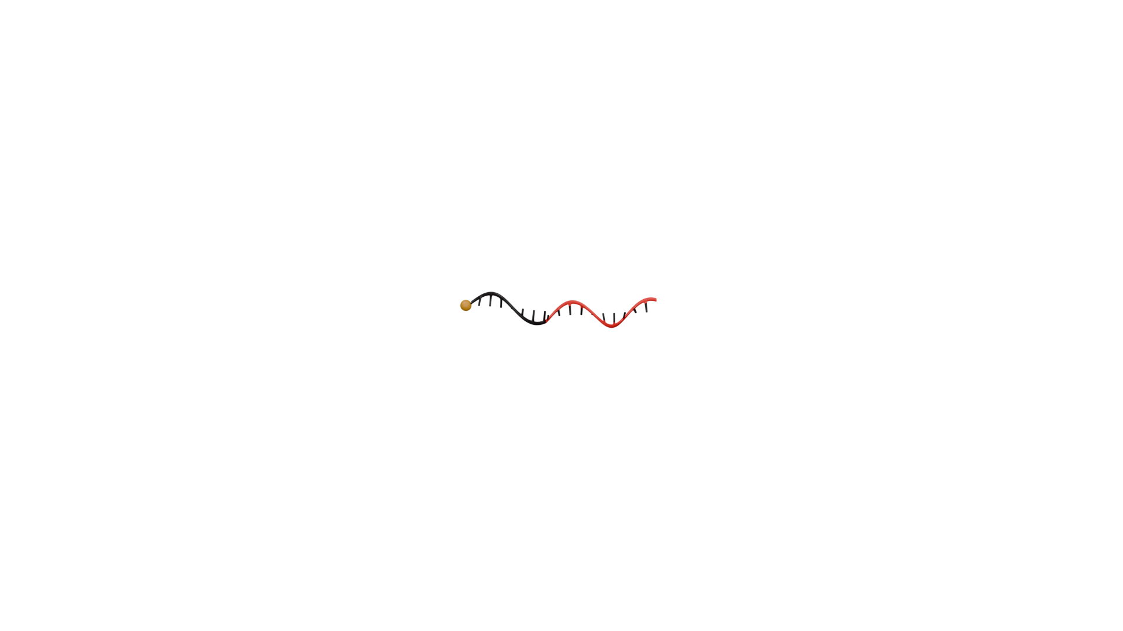
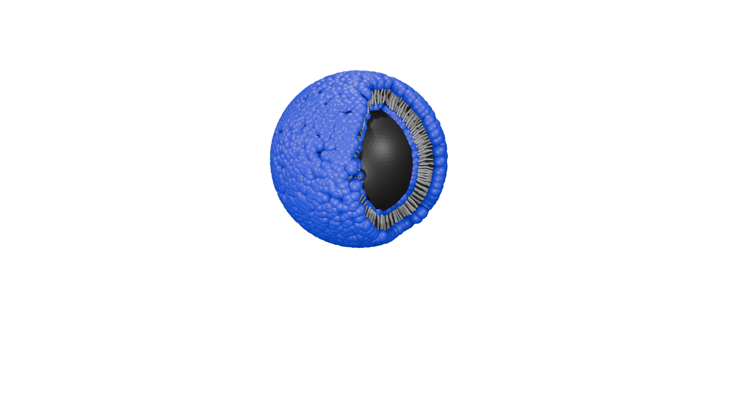
Validating Molecular Simulations

Slide 3
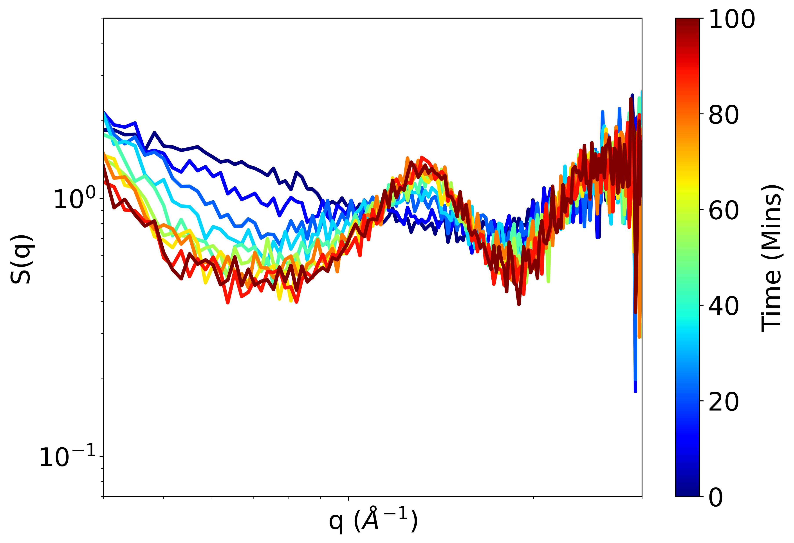
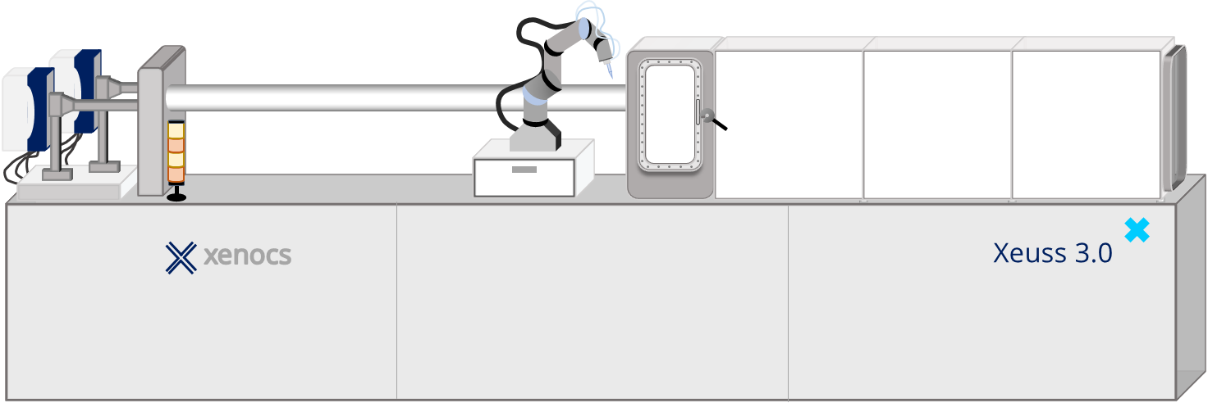
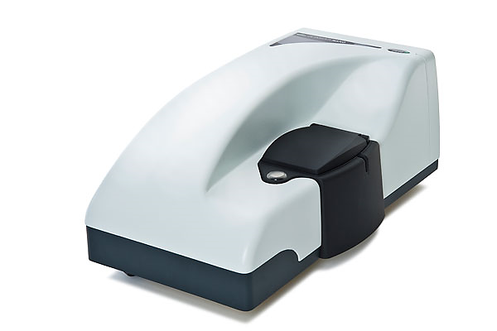
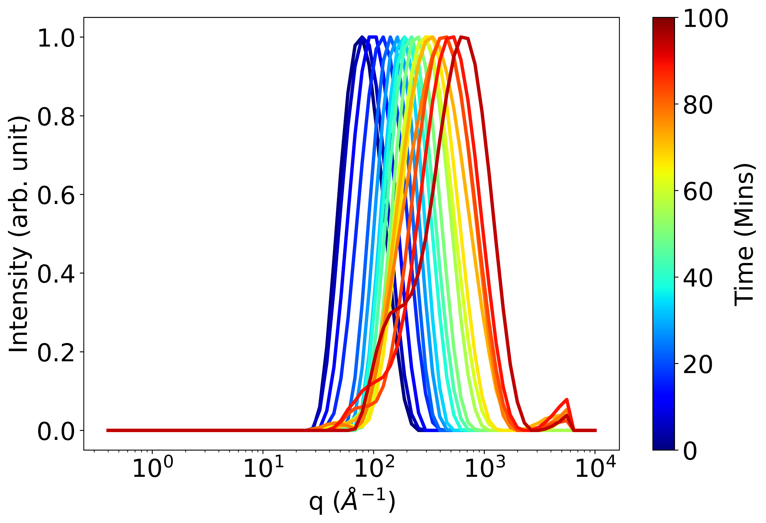
Experimental Data Collection

Slide 4
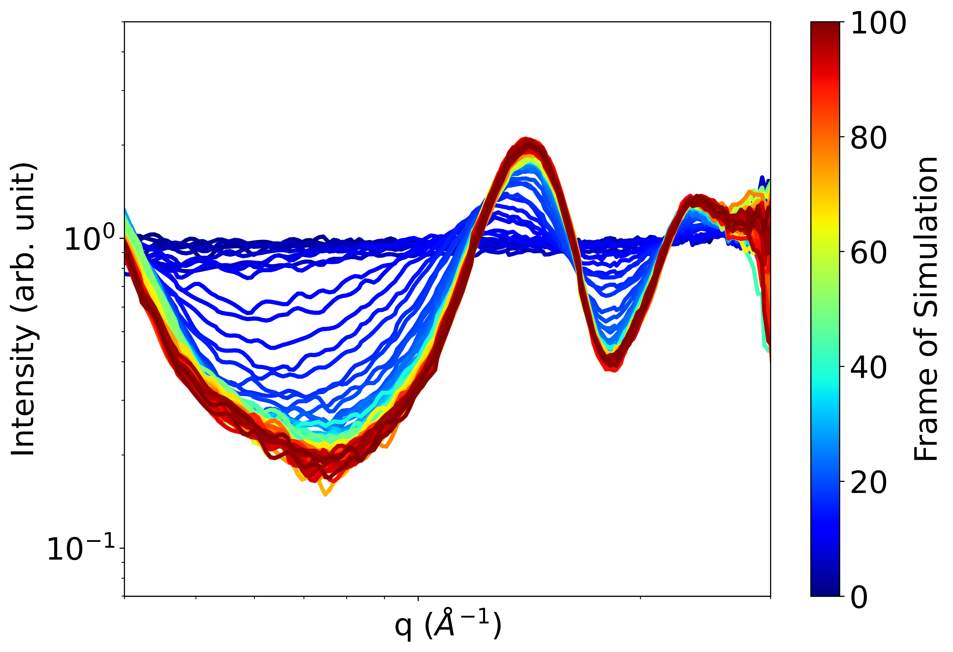
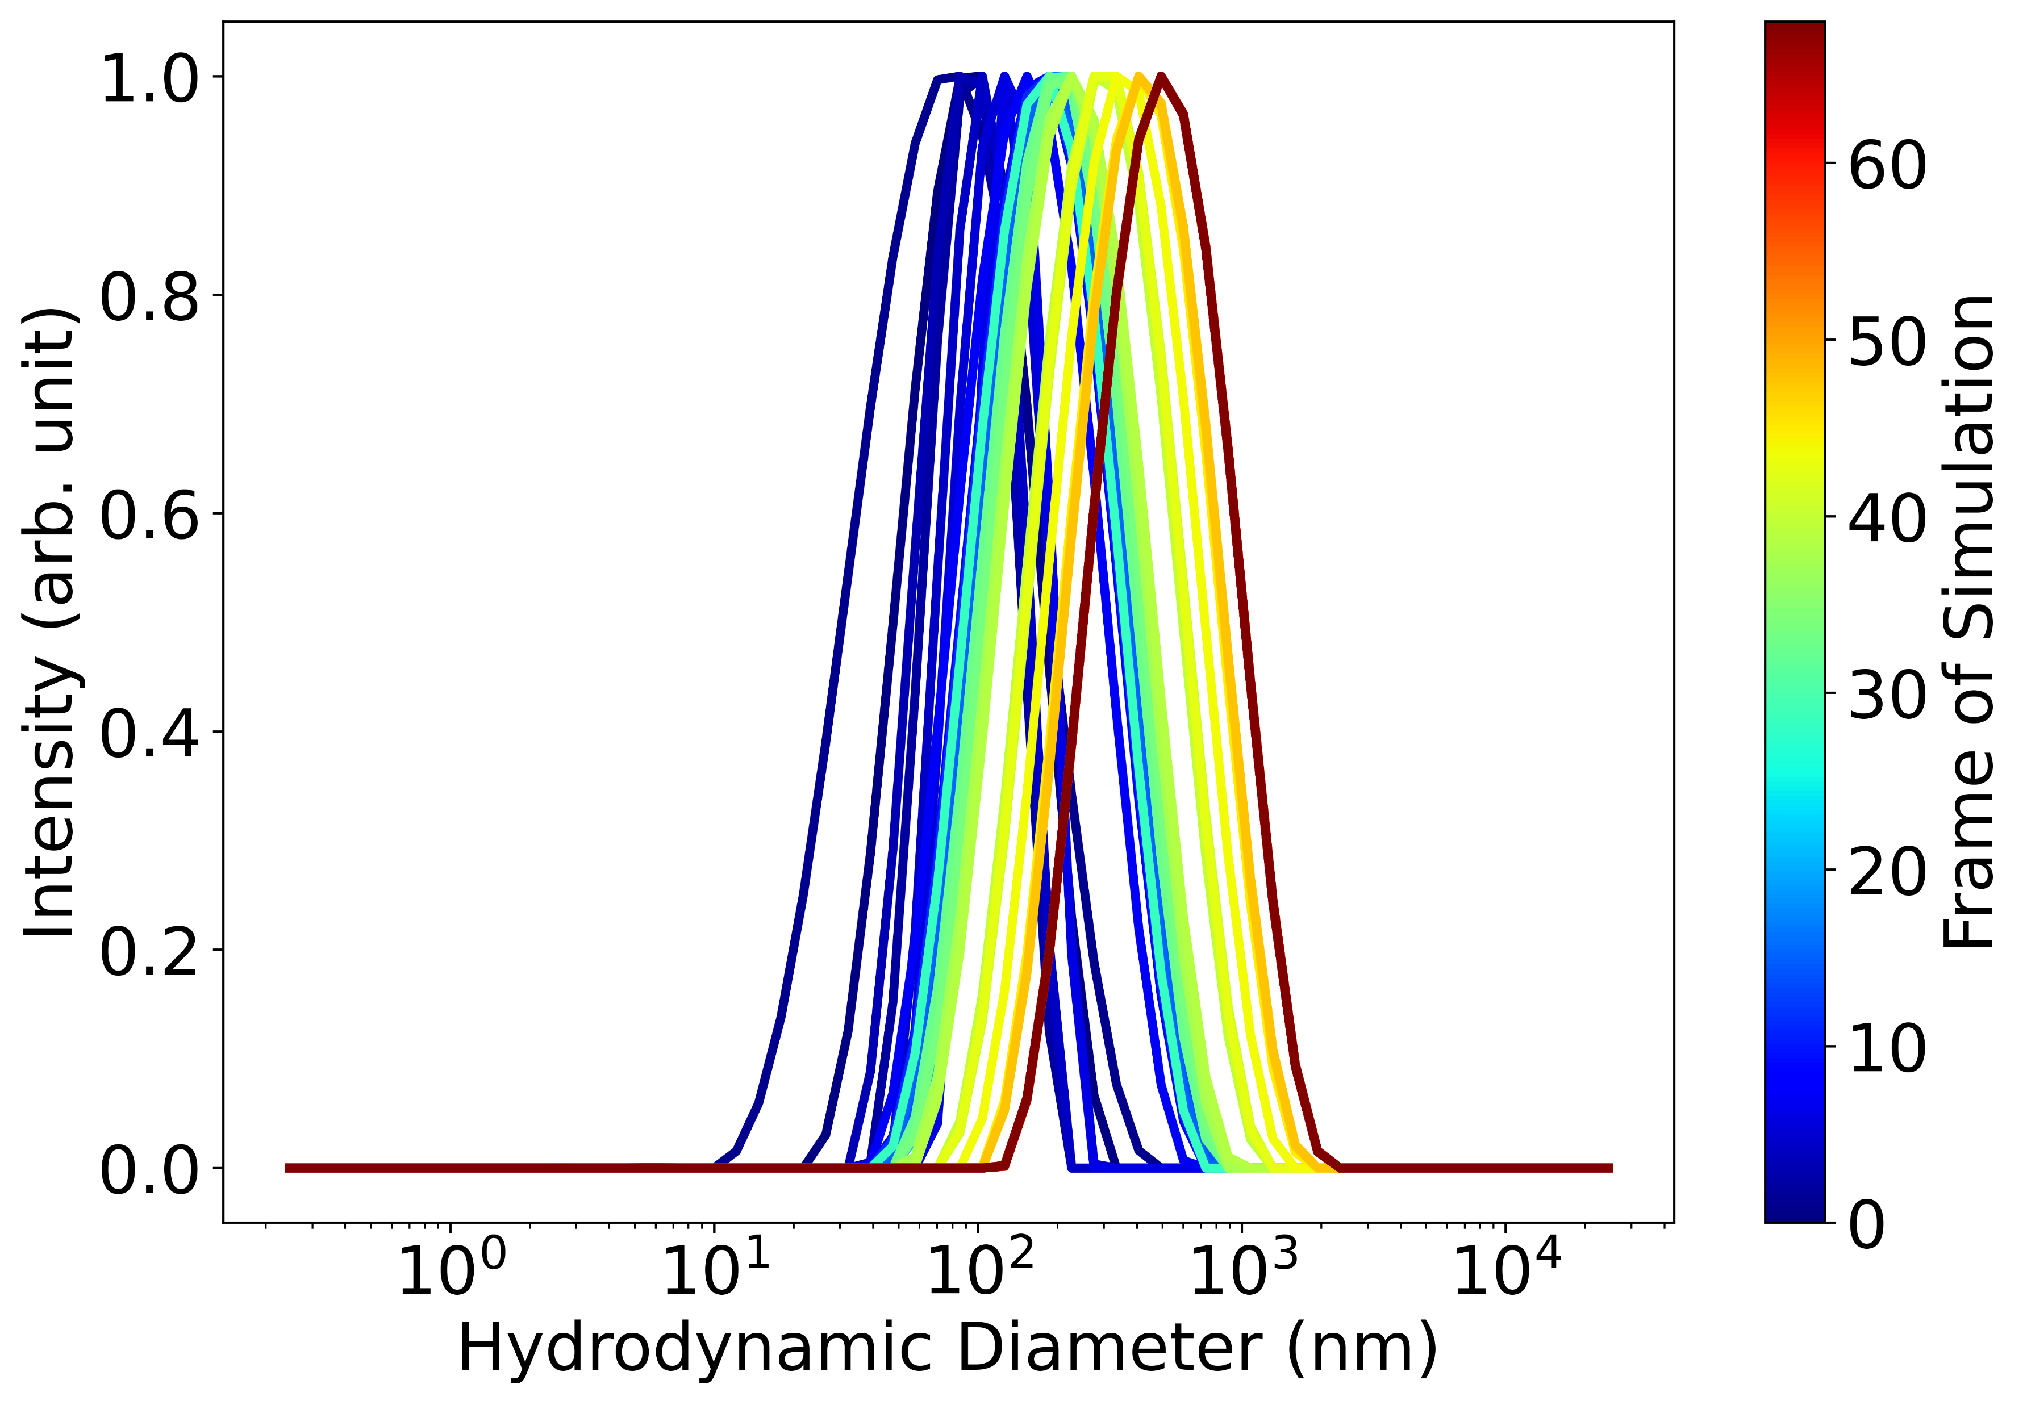
Simulation Data

Slide 5

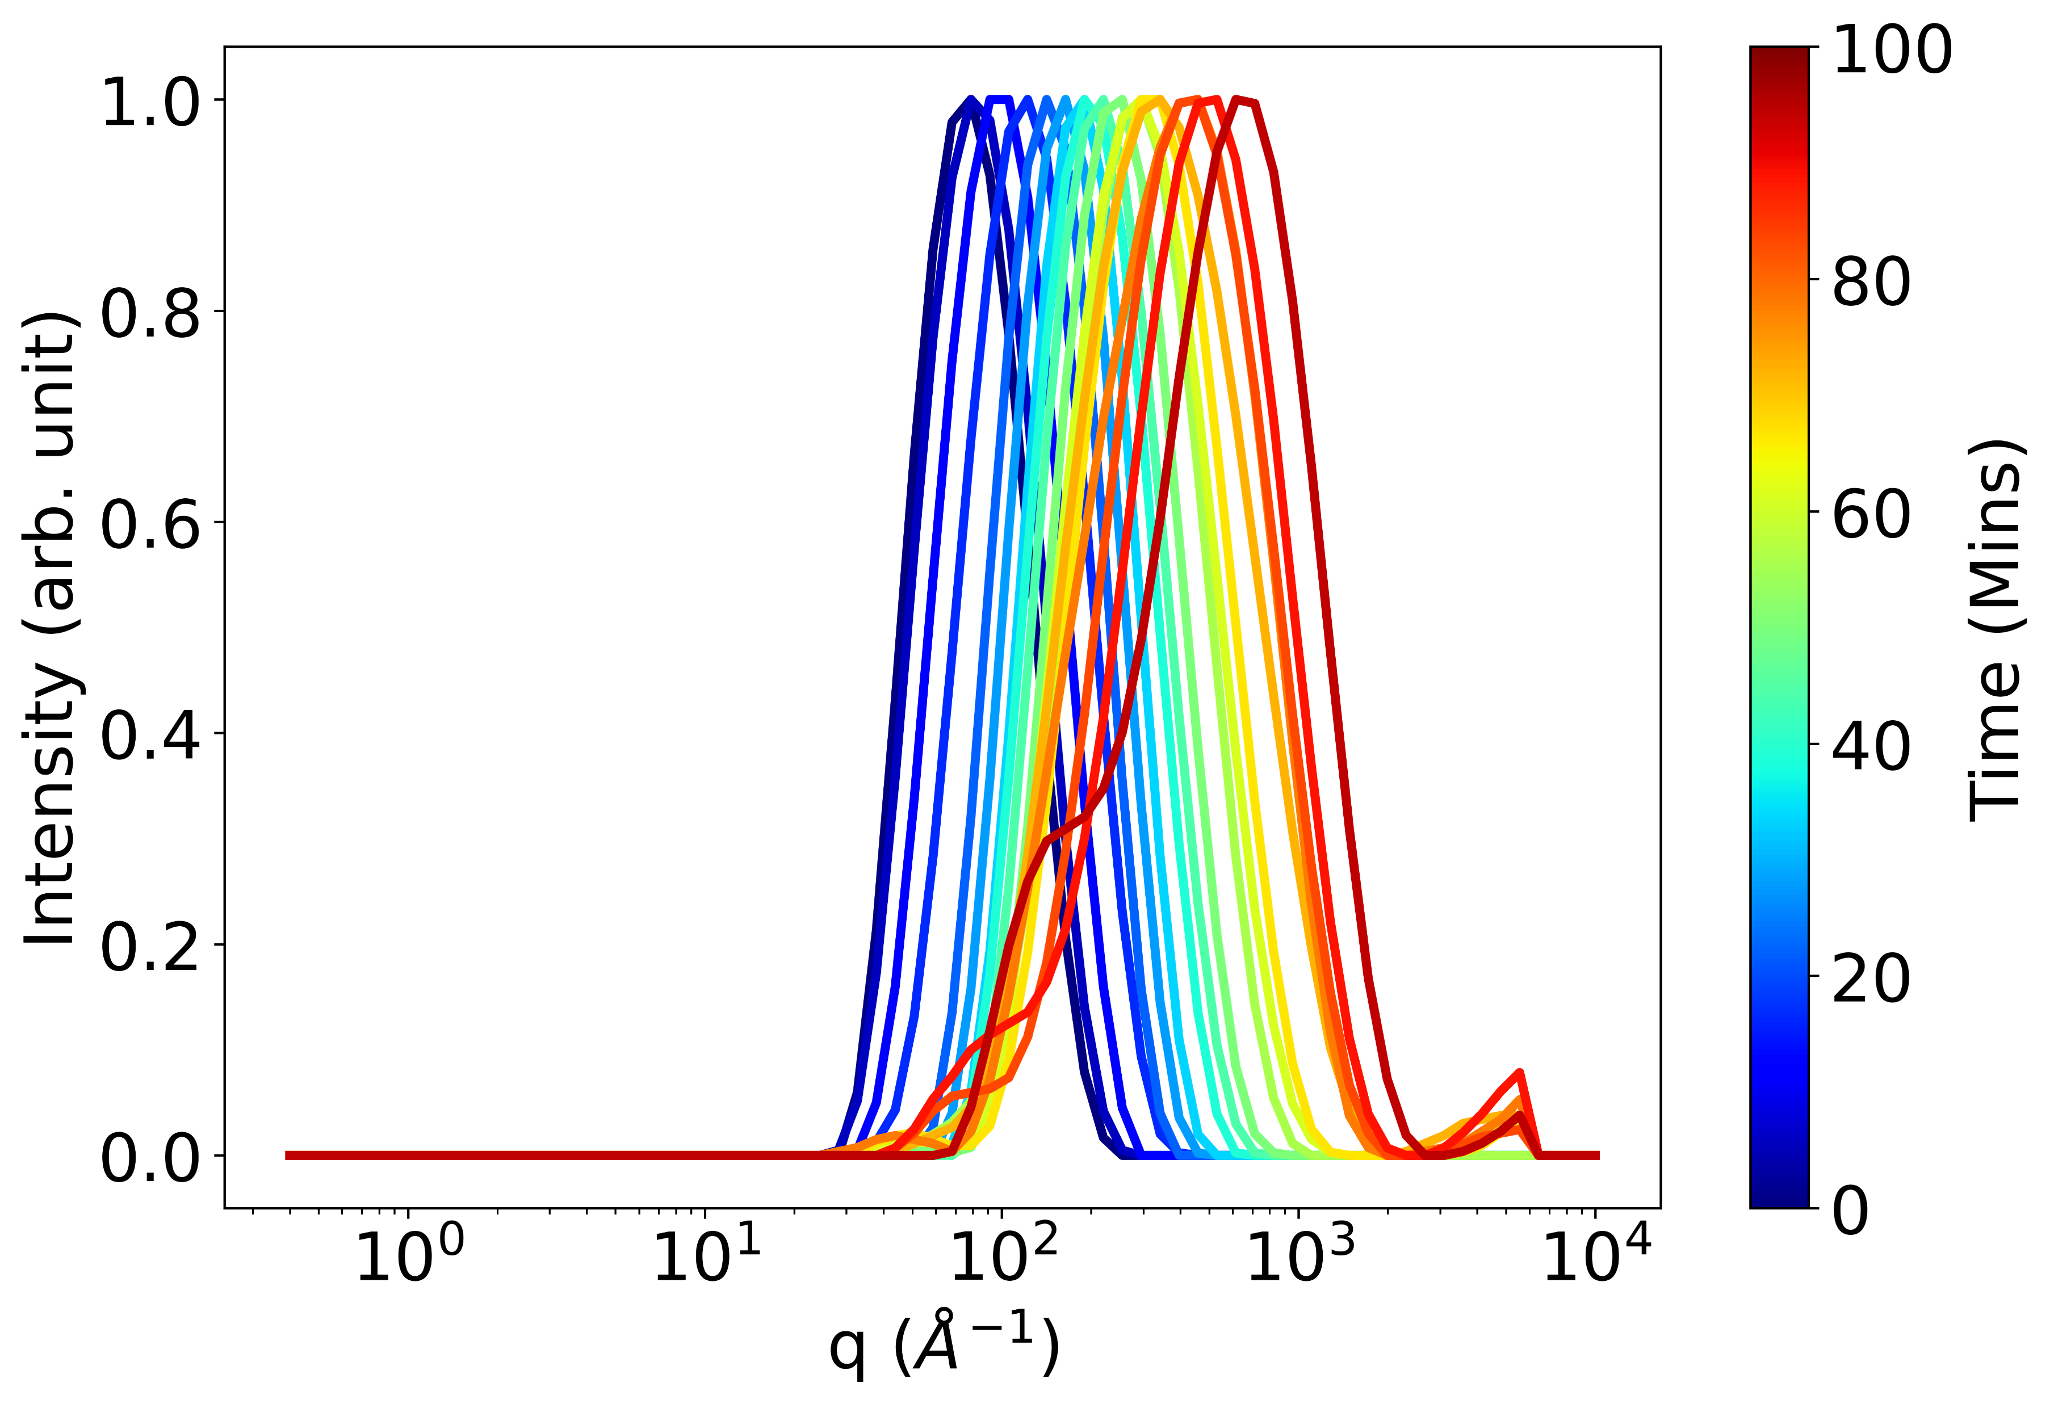
Compare Series of Curves
Experimental
Simulation
SAXS
DLS

Slide 6
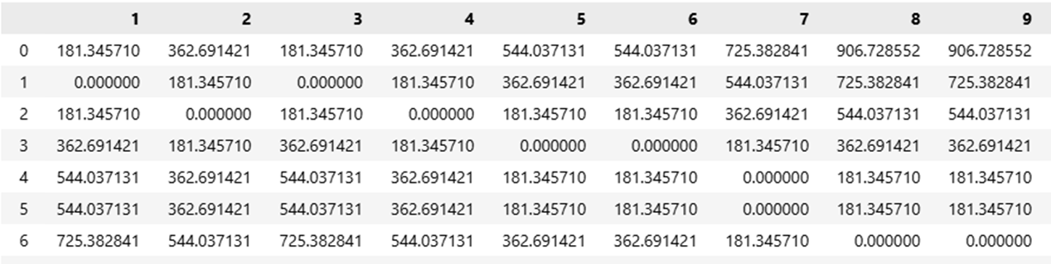
Method
Simulated Data
Experimental Data

Slide 7
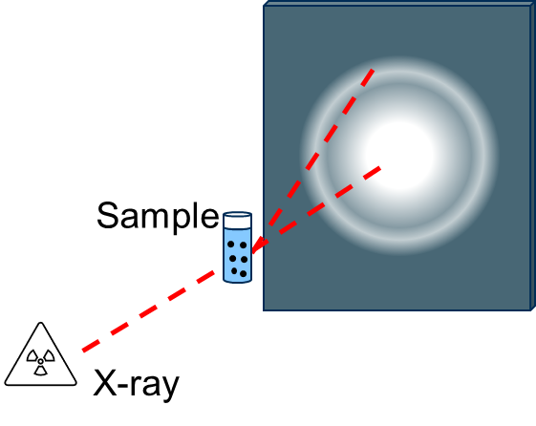
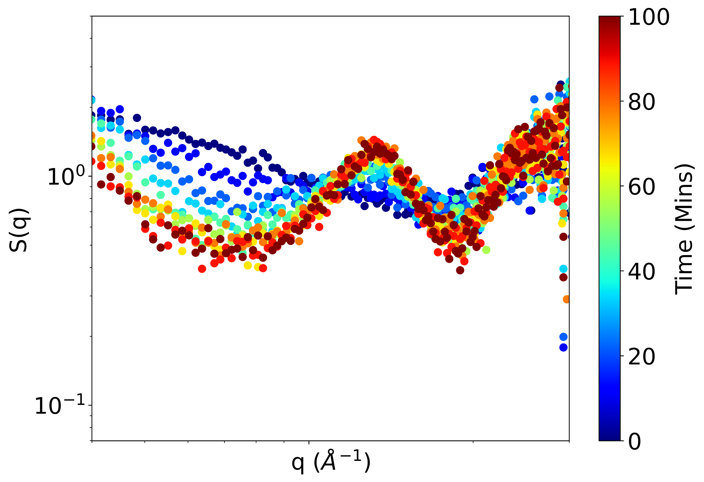
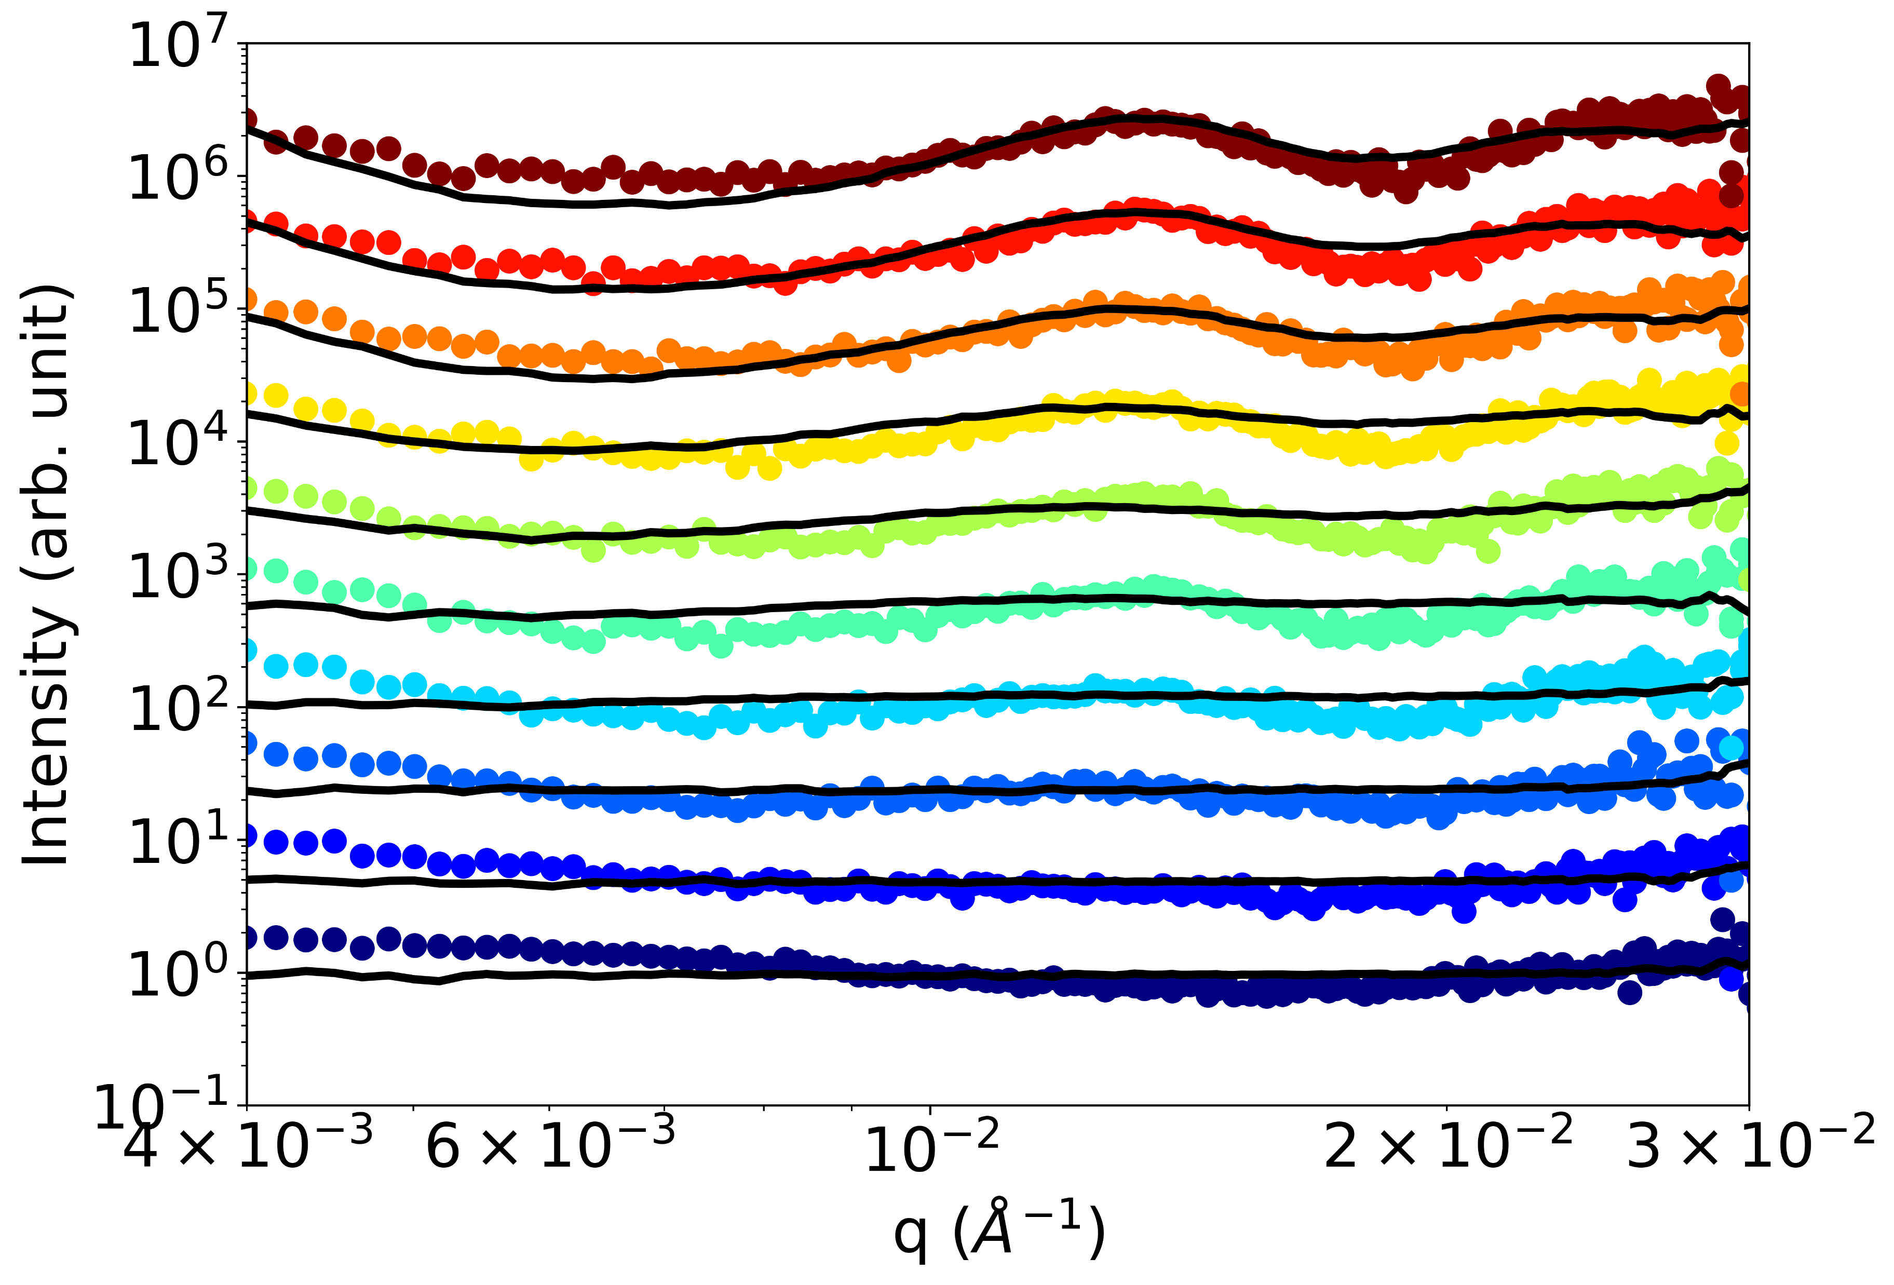

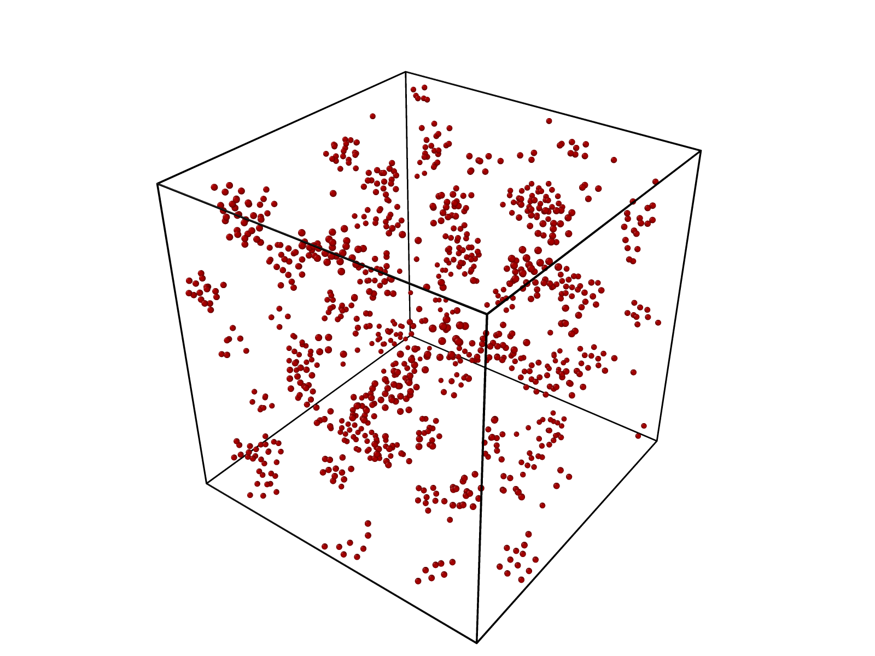


Experimental SAXS of Particle Assembly
Match Simulation to Experiment Using Series Alignment
$$S(q, t)$$
Simulated SAXS of Particle Assembly
$$S(q, t)$$

Slide 8
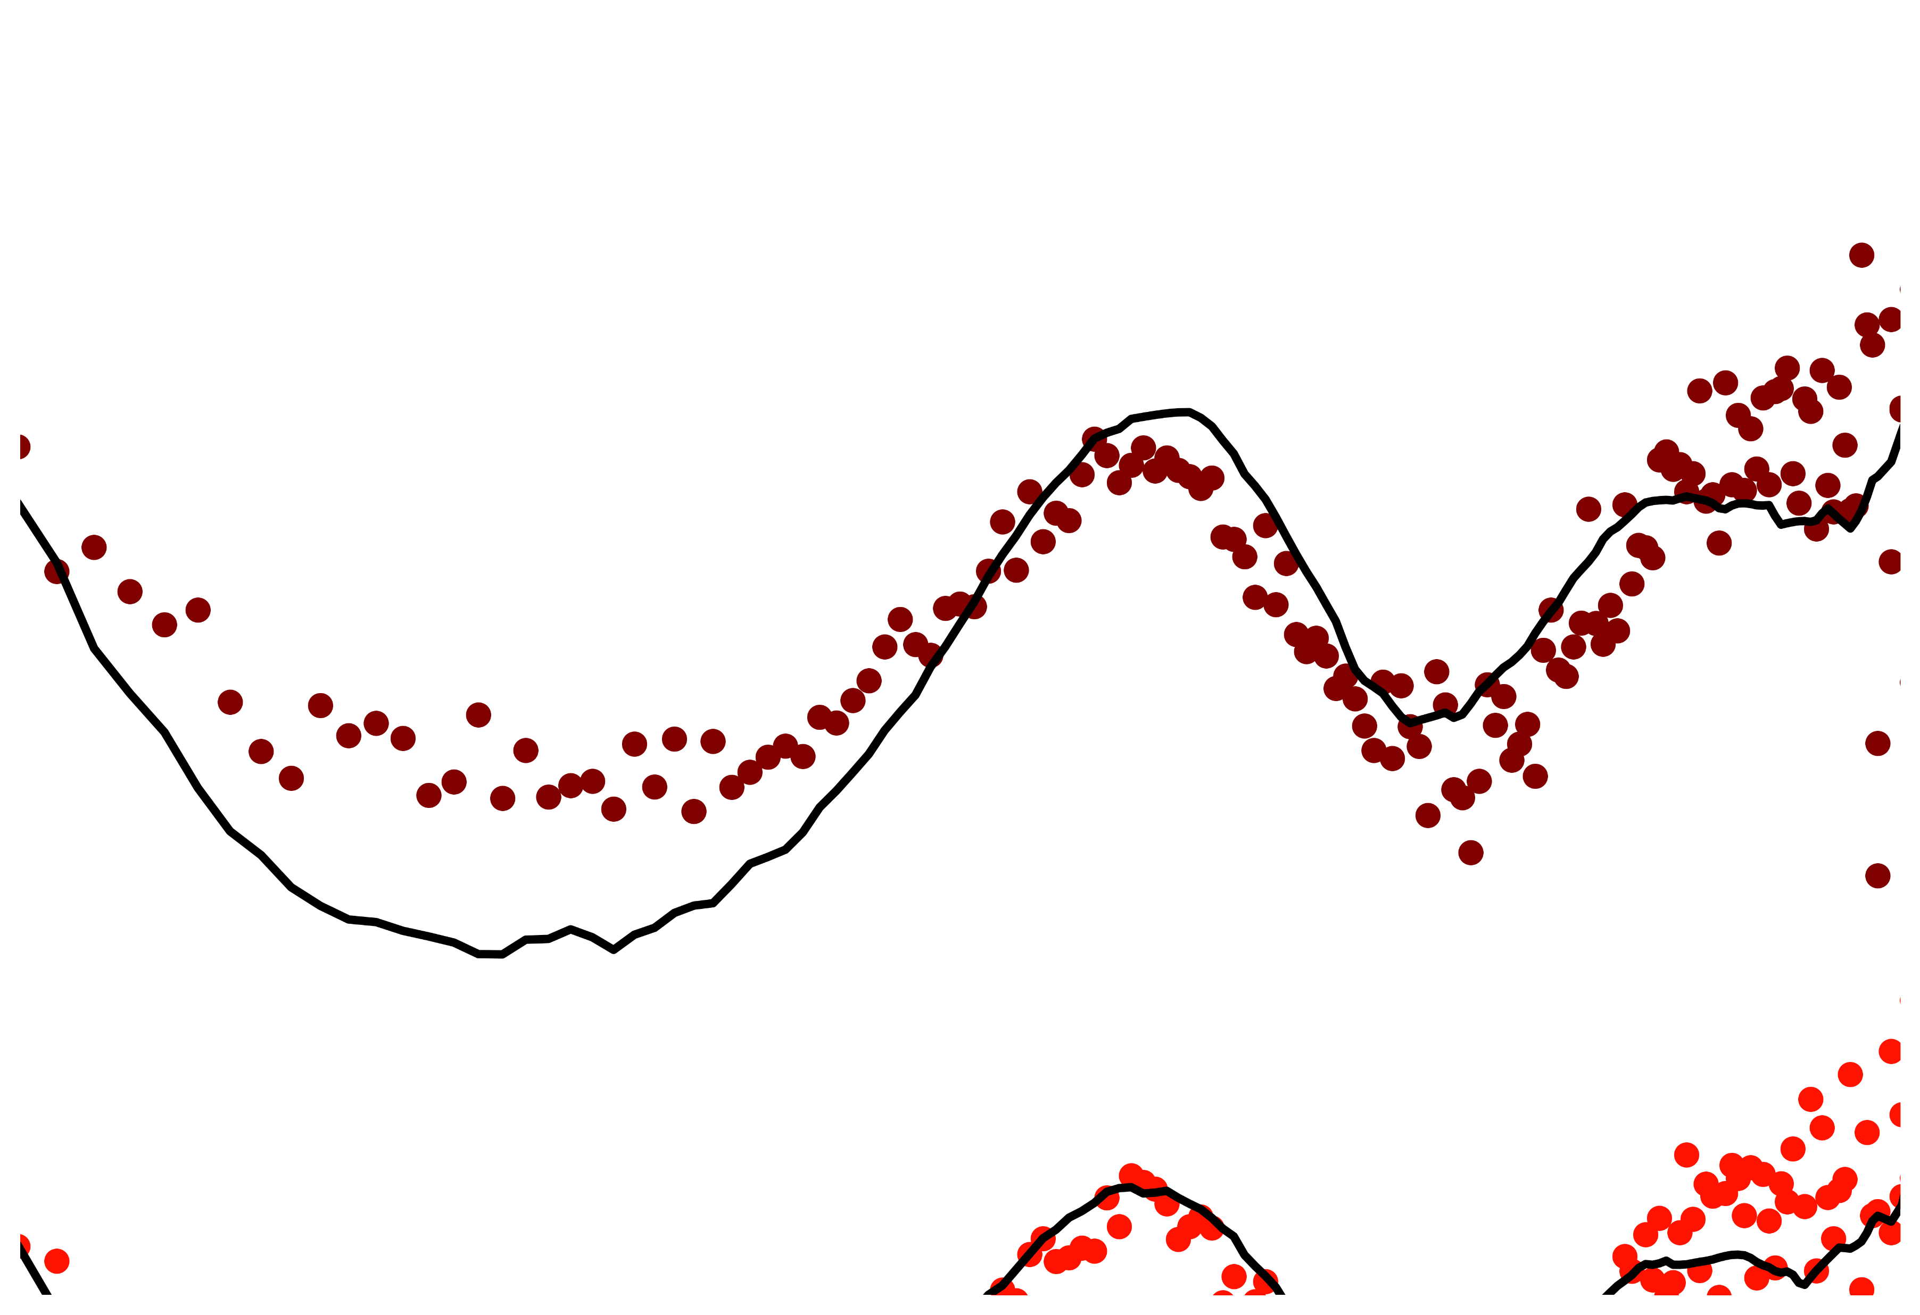
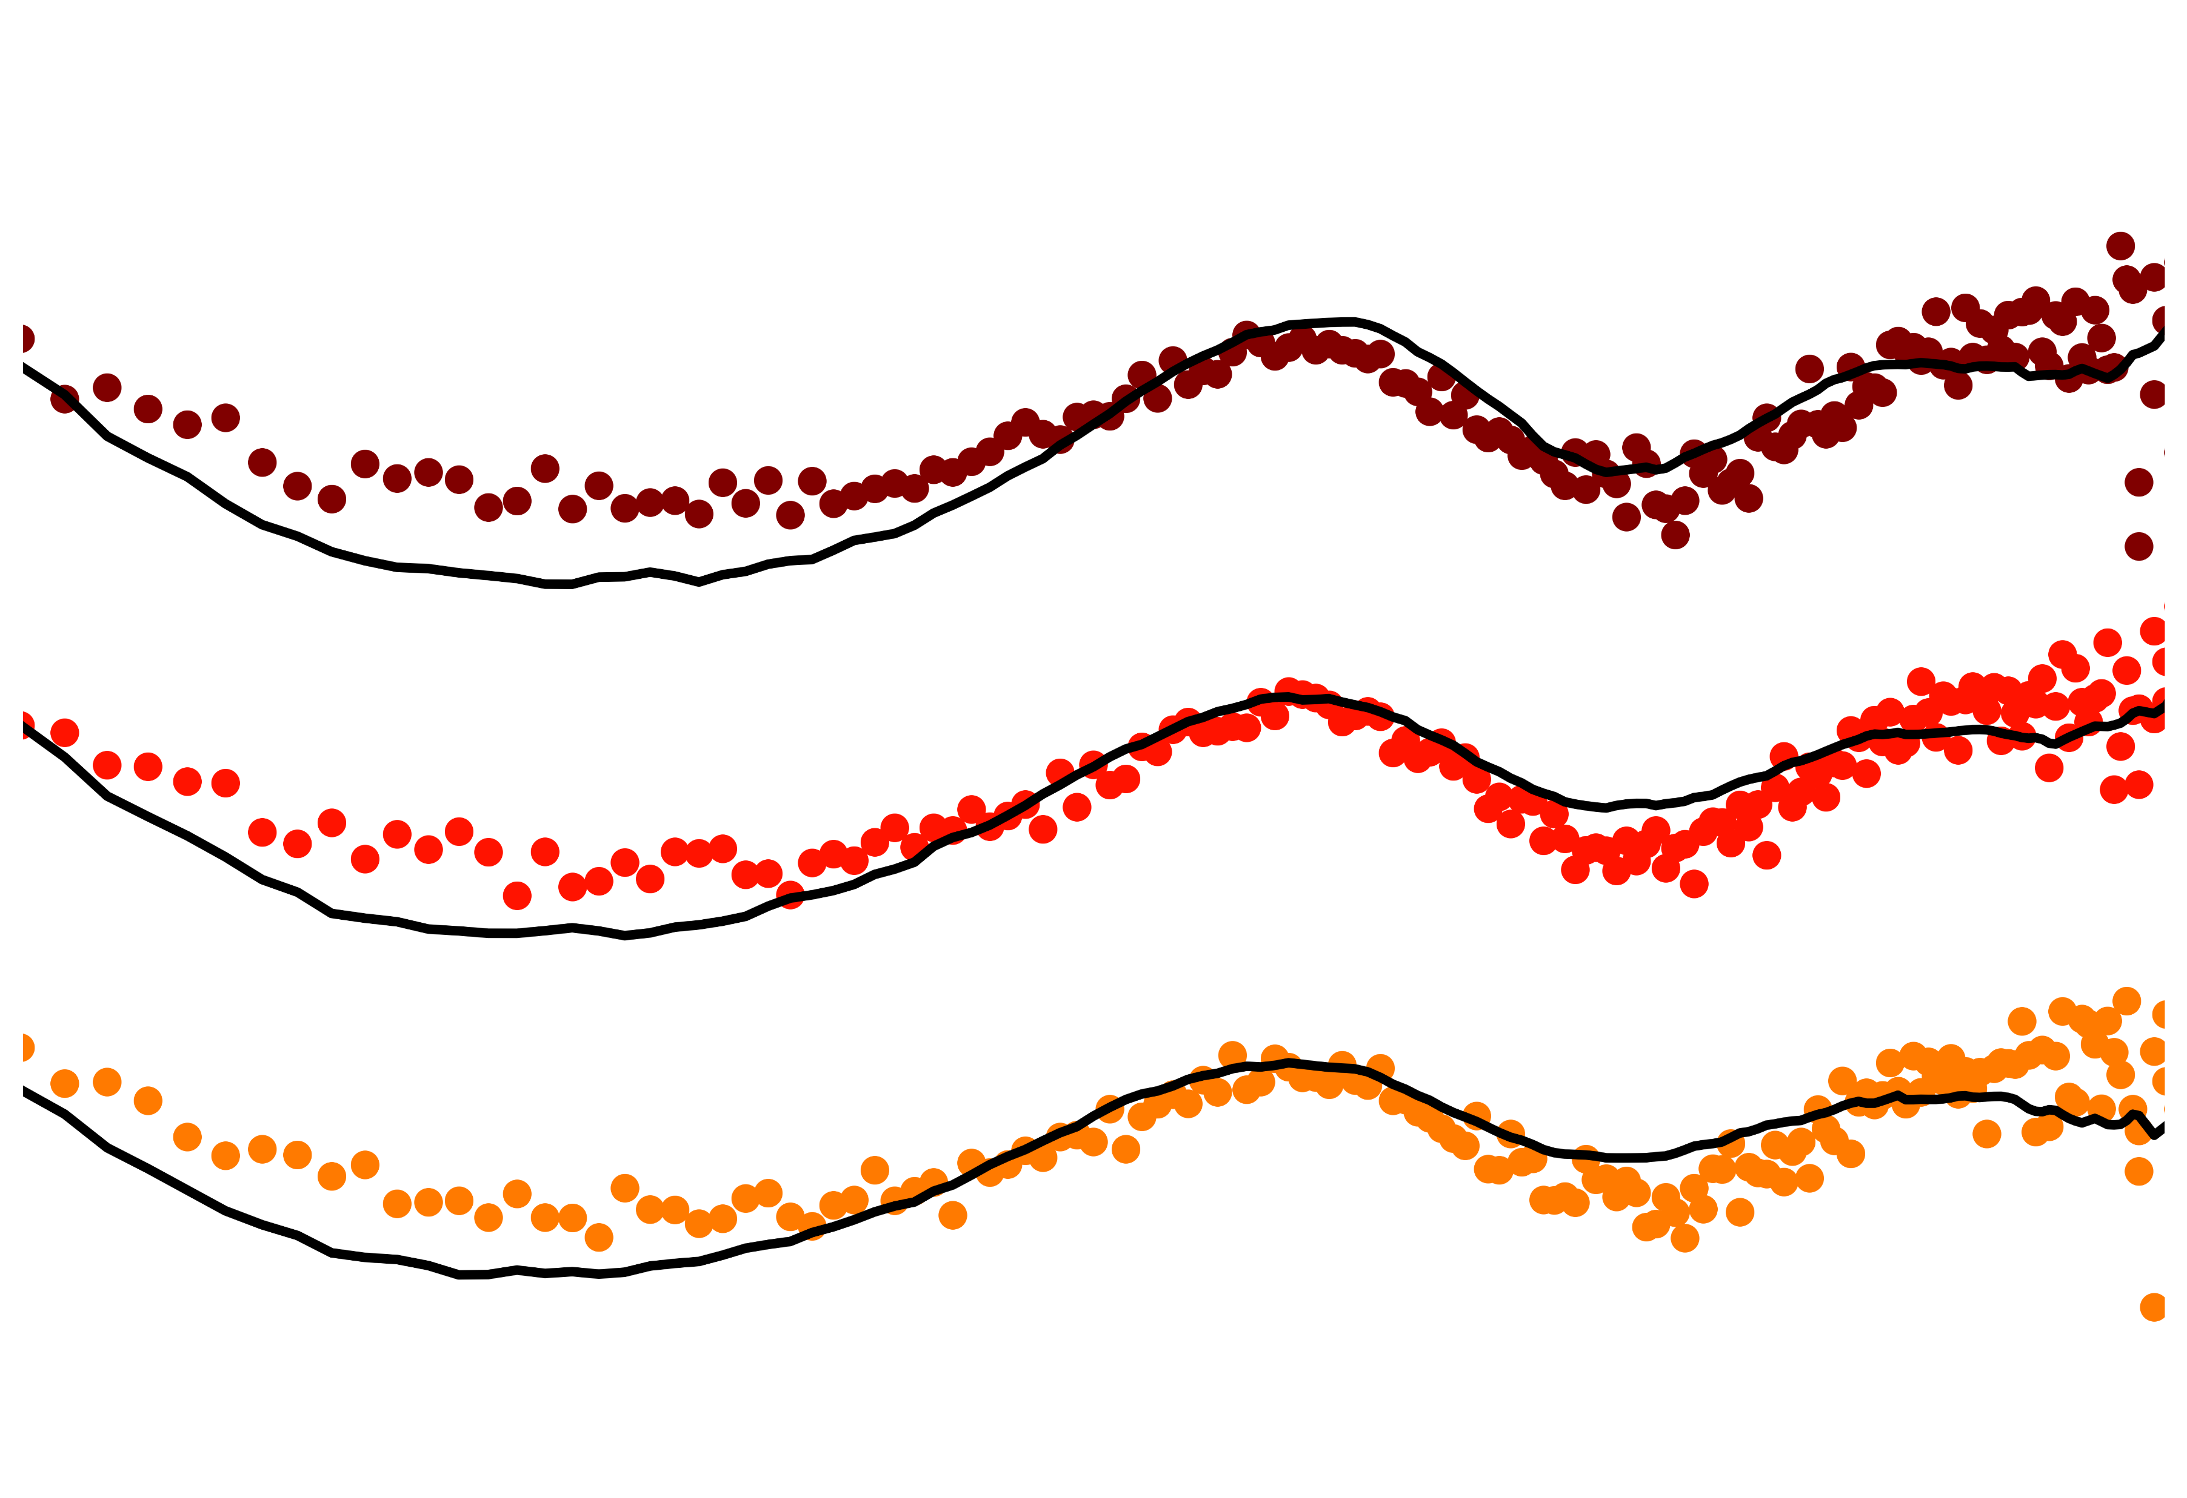
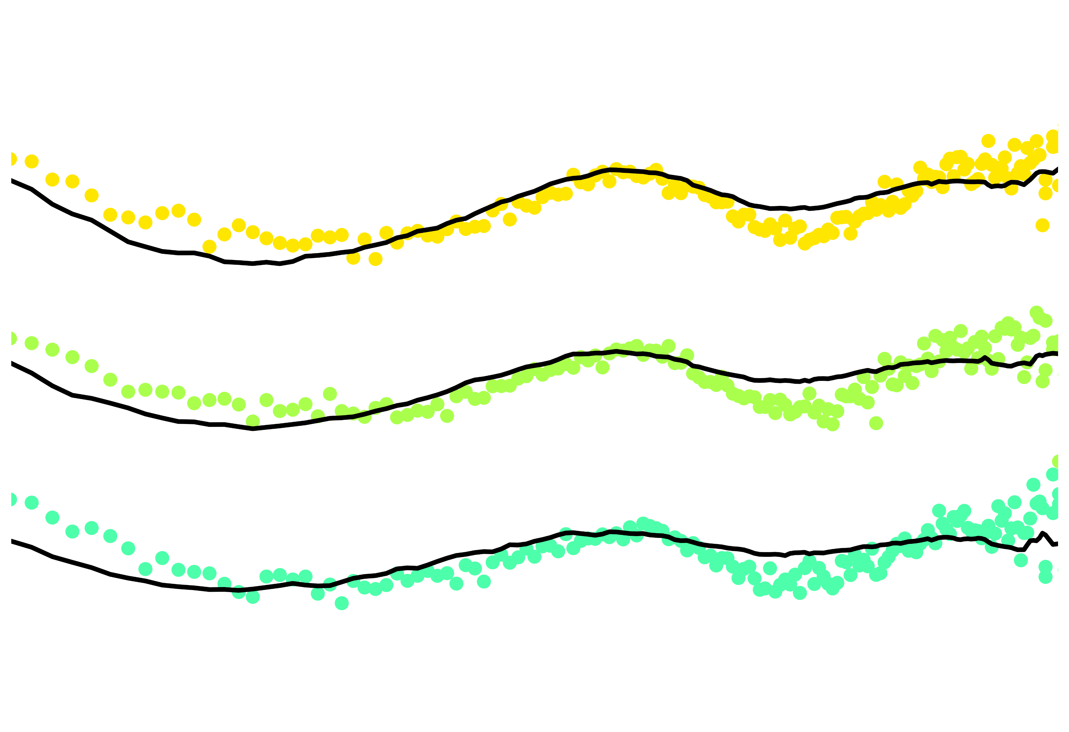
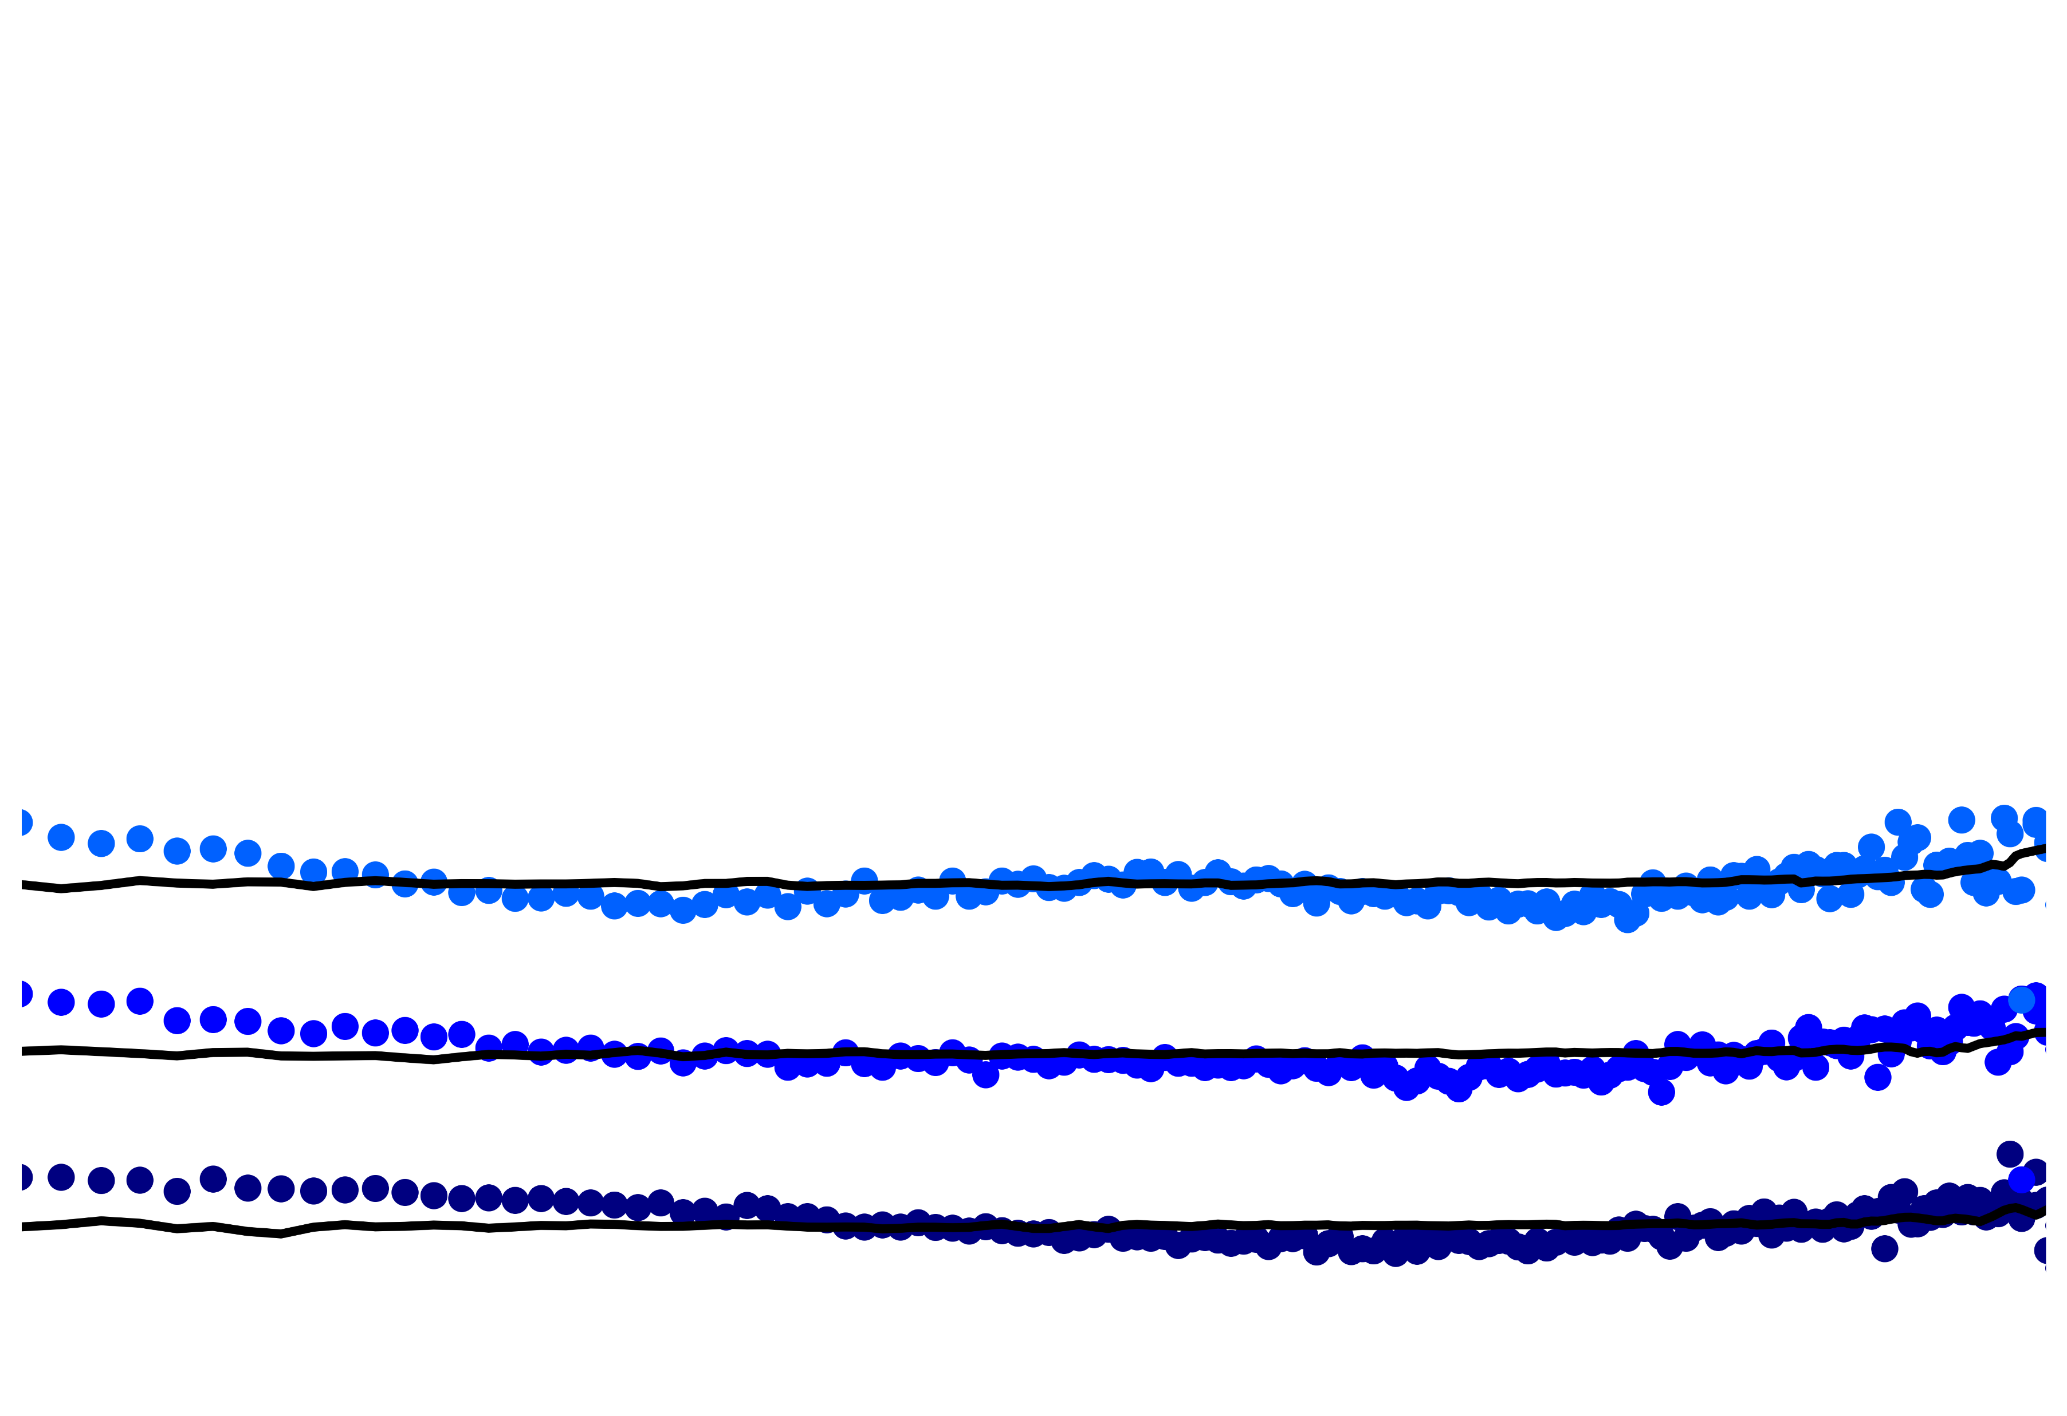
Experimental SAXS of Particle Assembly
Match Simulation to Experiment Using Series Alignment
$$S(q, t)$$
Simulated SAXS of Particle Assembly
$$S(q, t)$$

Slide 9
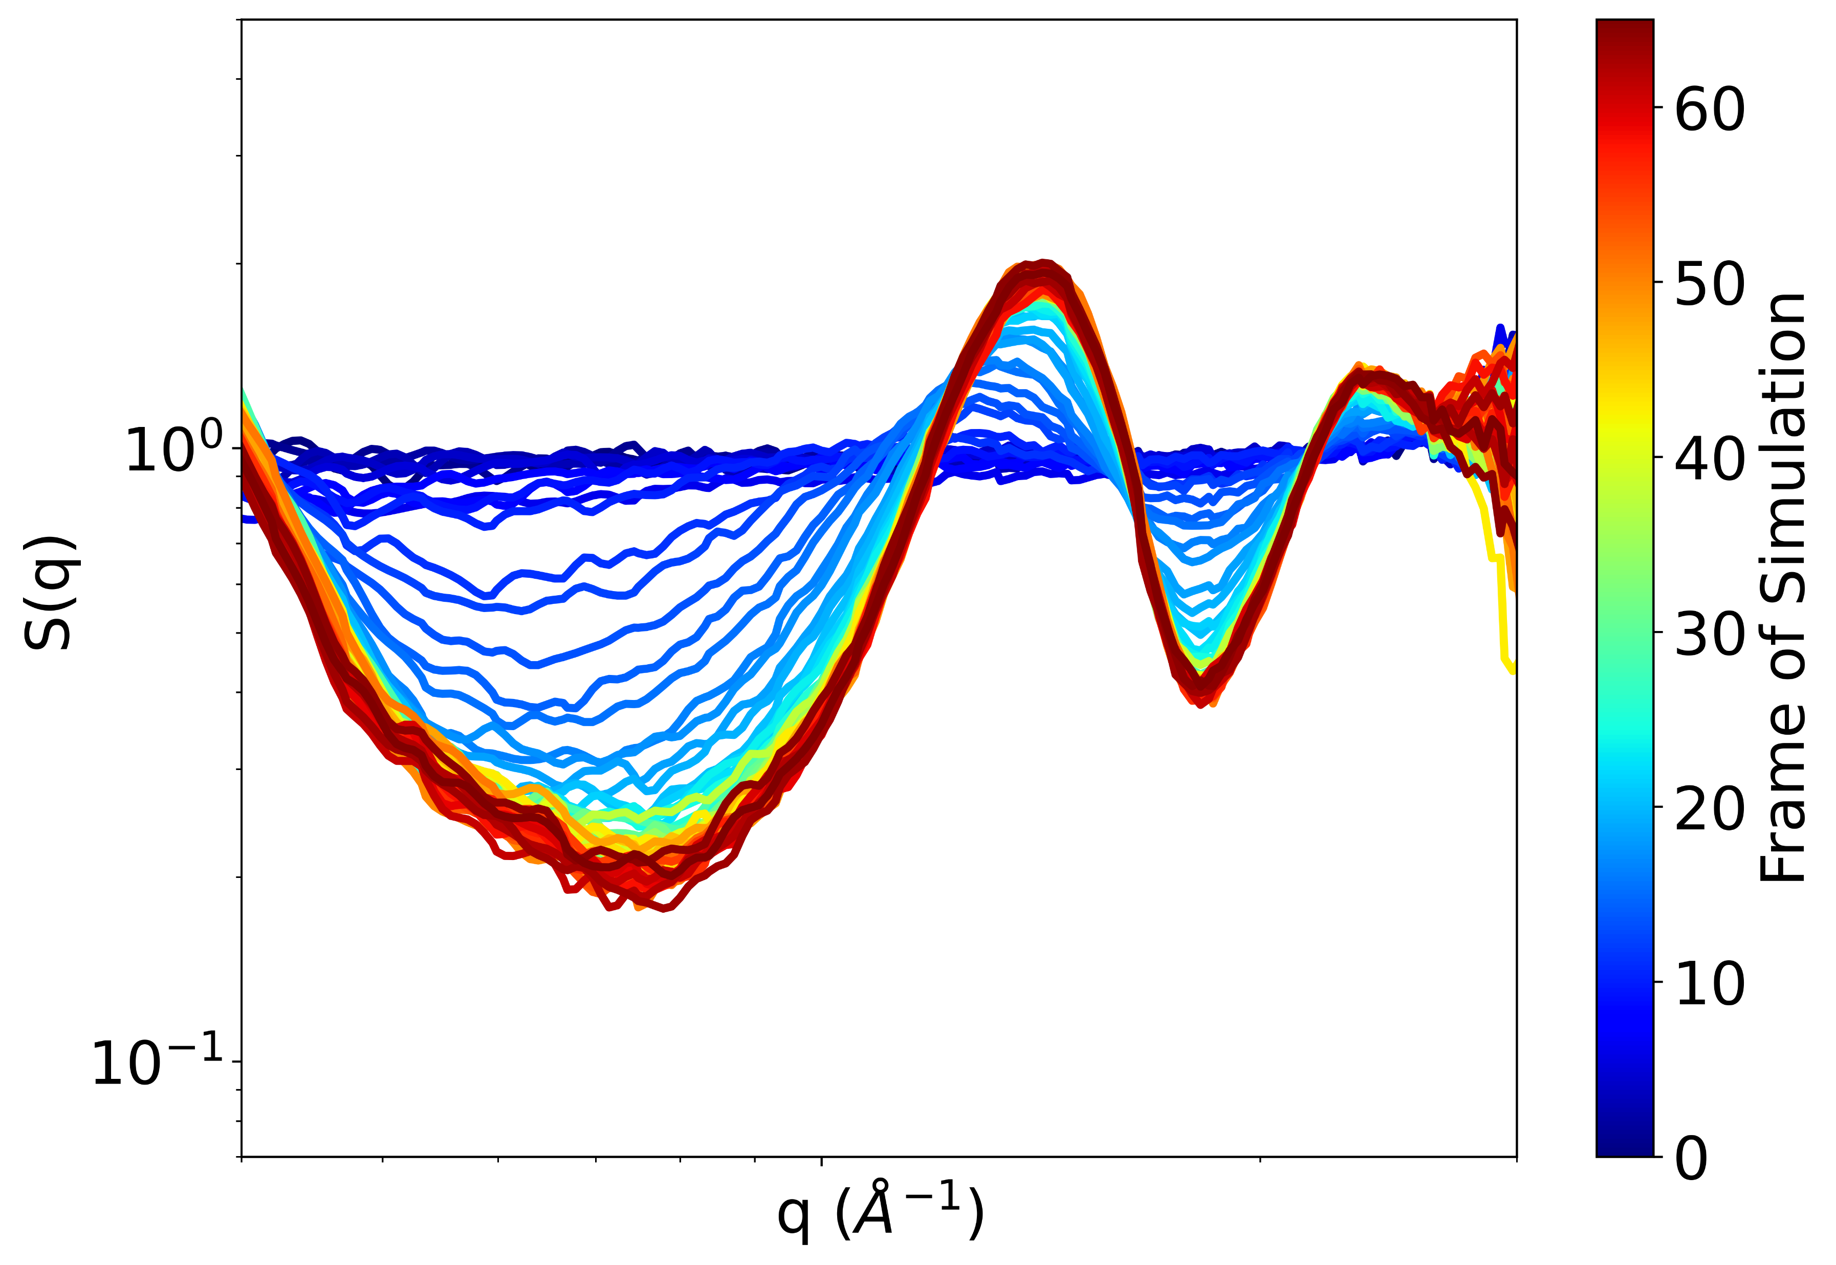
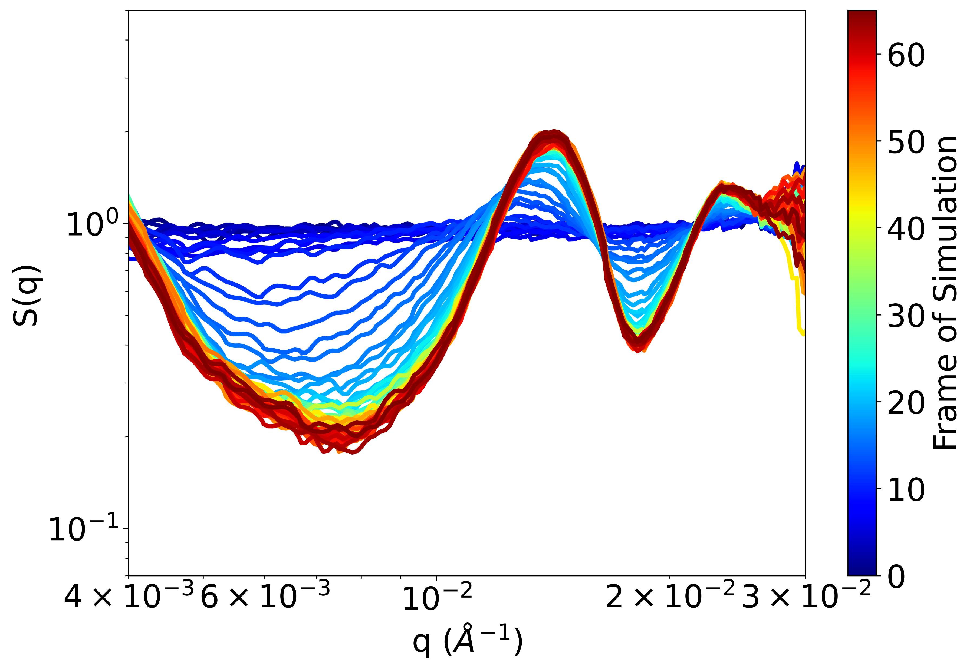
A.
B.

Slide 10
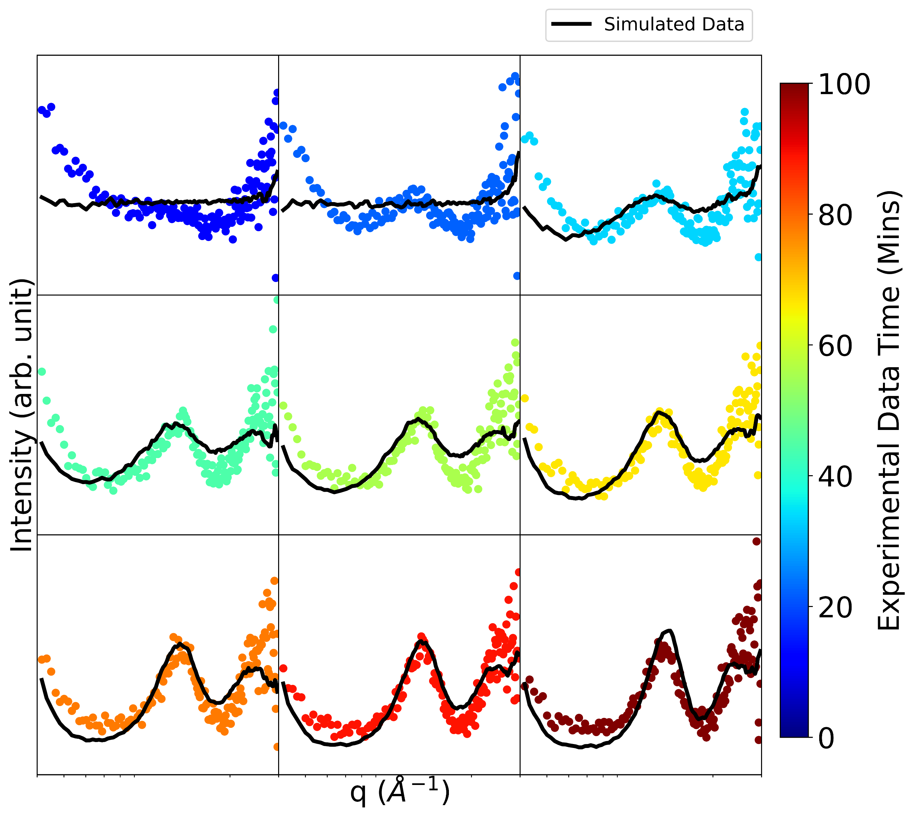
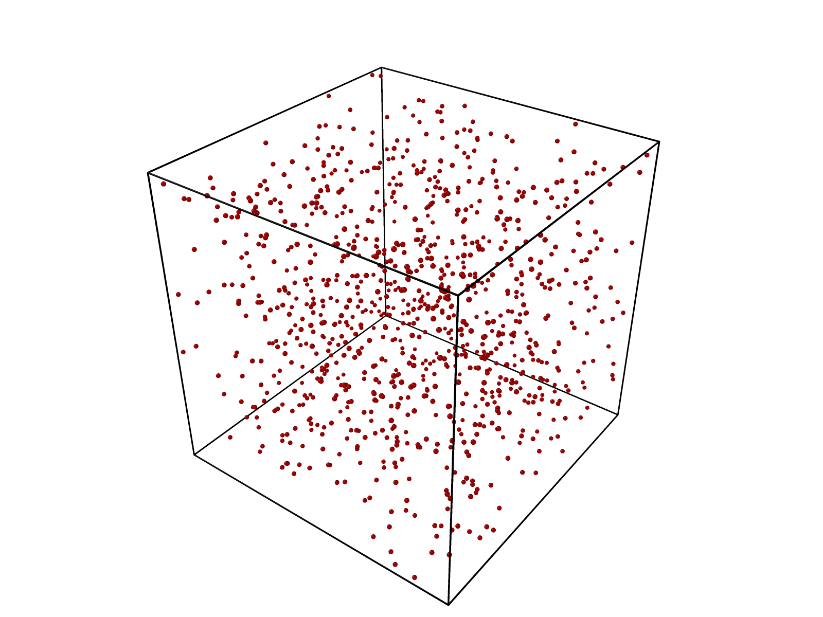
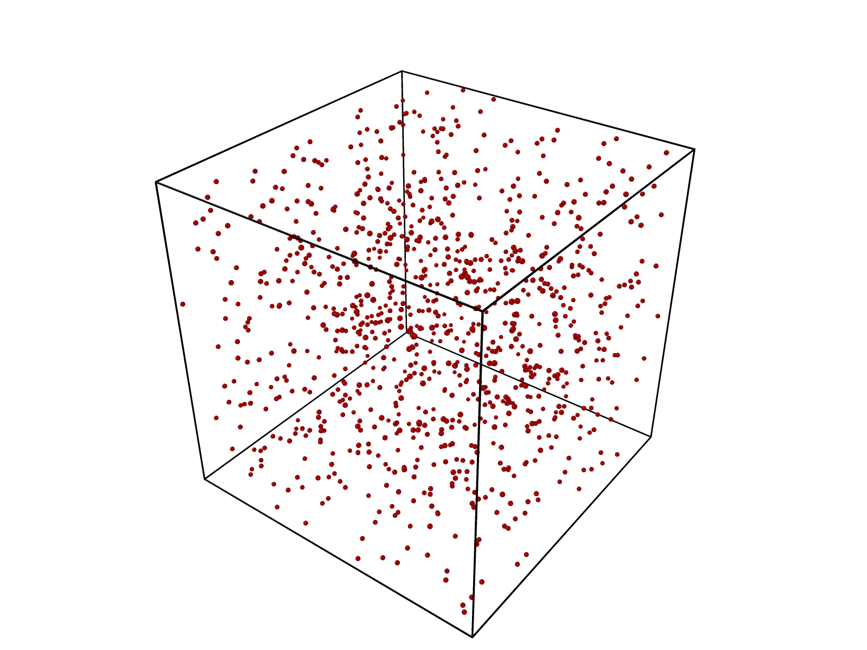
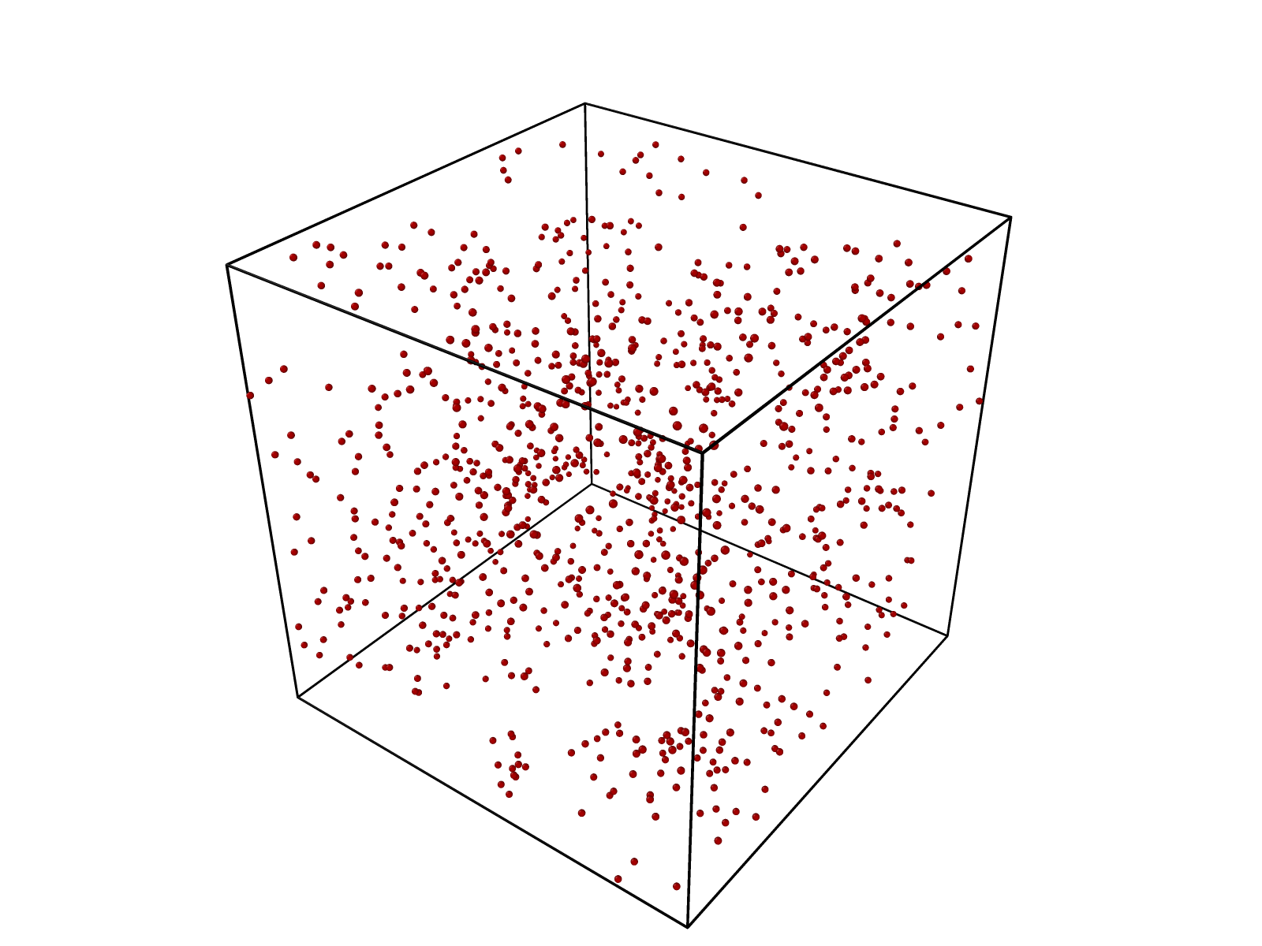
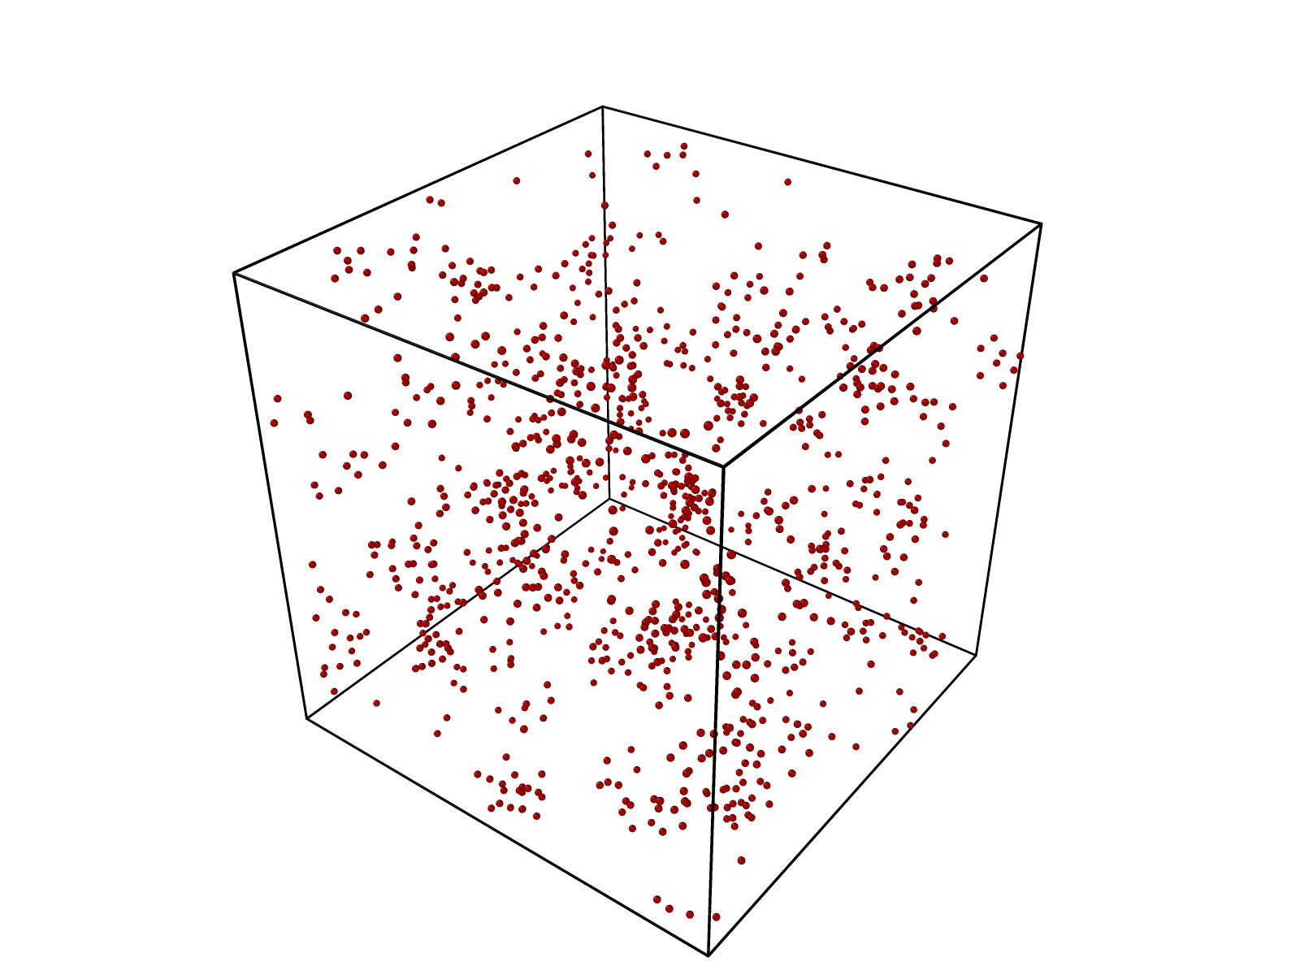
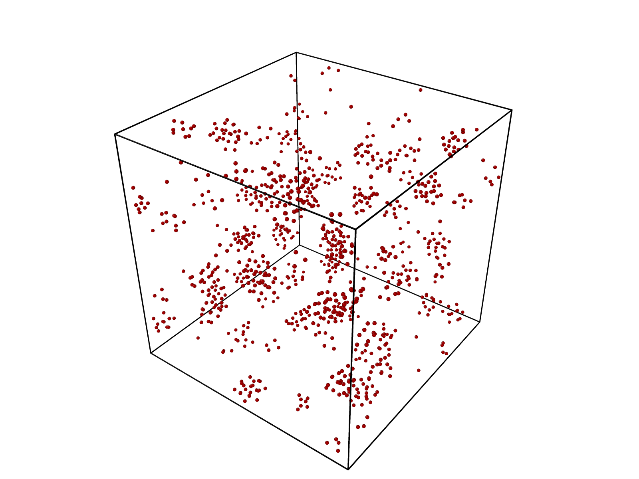
Results SAXS
A.
B.
0 Mins
20 Mins
40 Mins
60 Mins
80 Mins

Slide 11
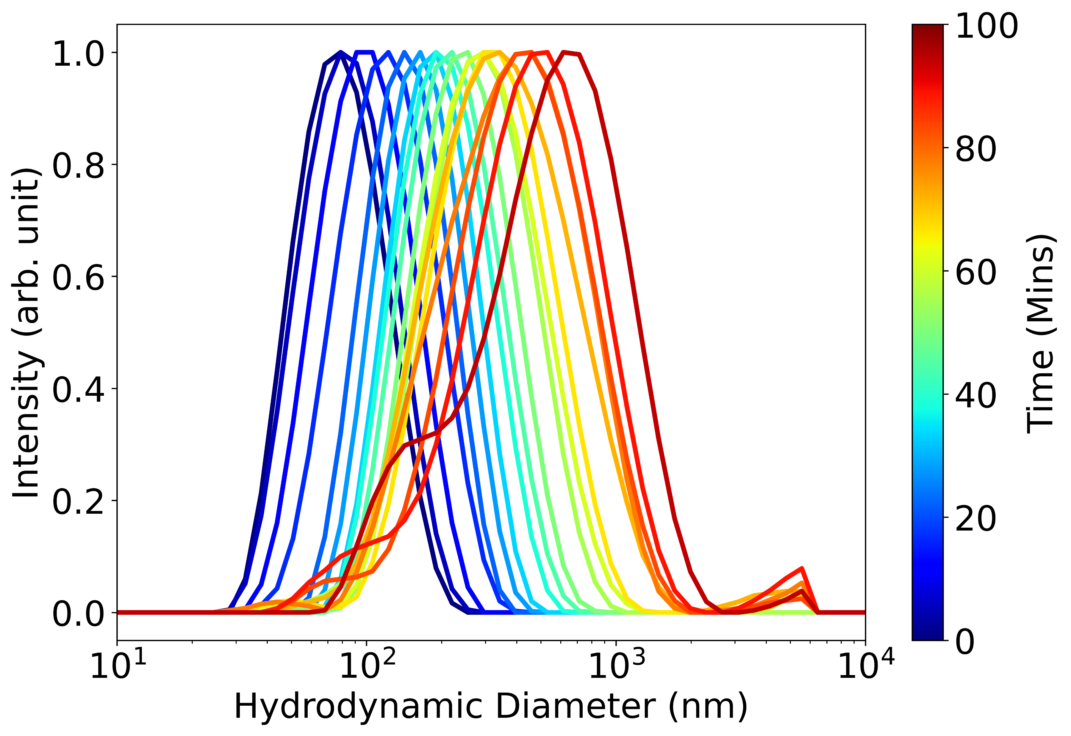
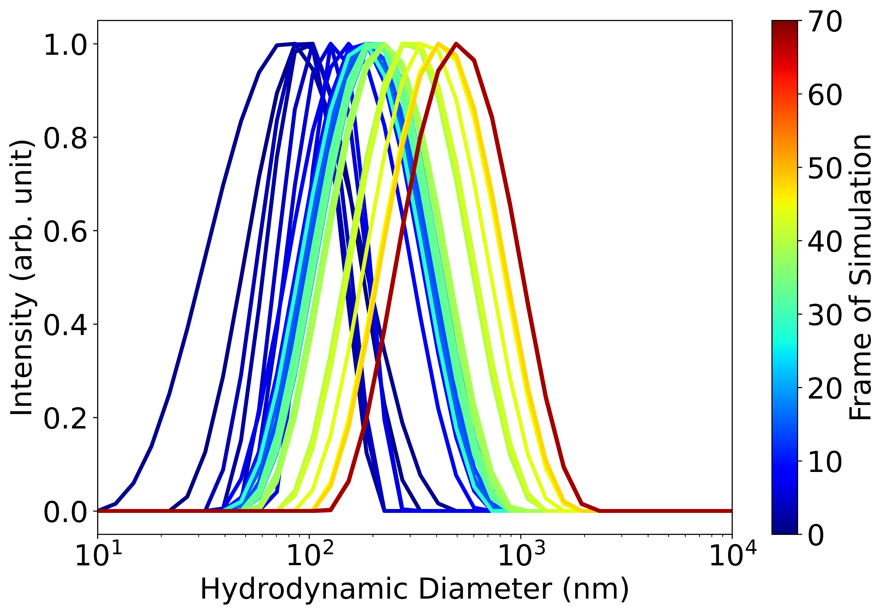
A.
B.

Slide 12
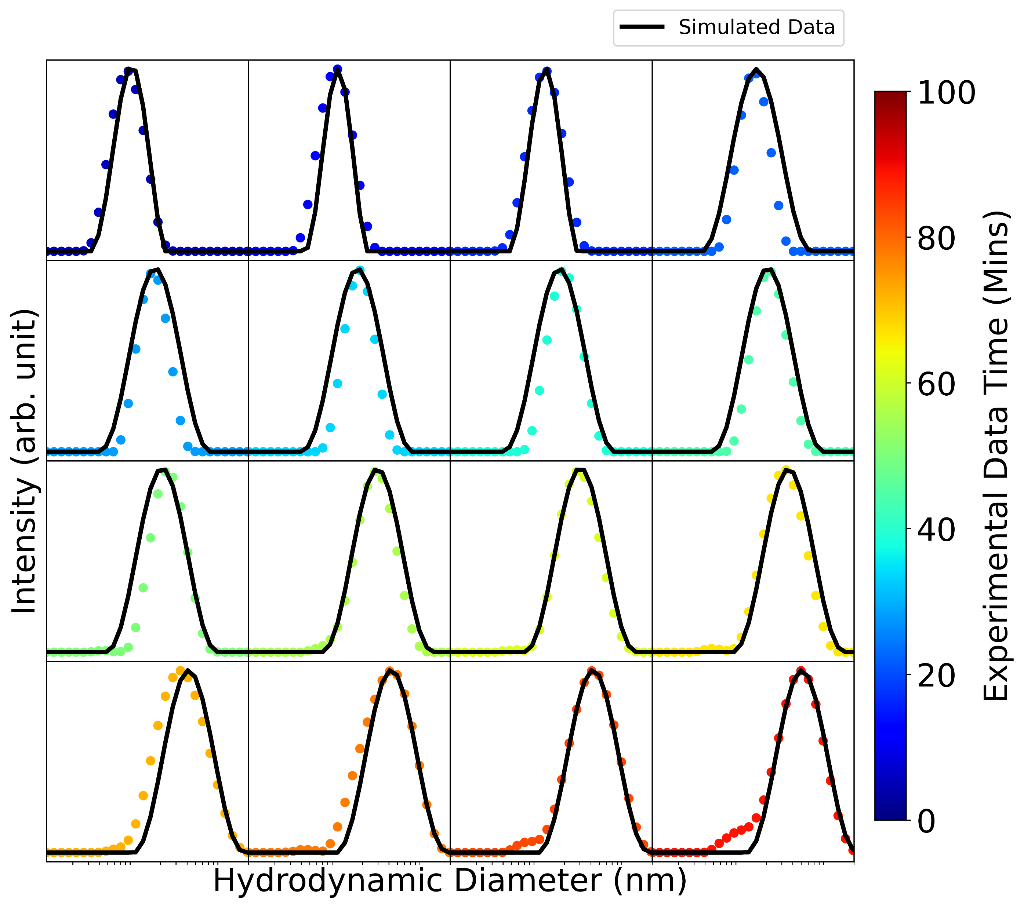
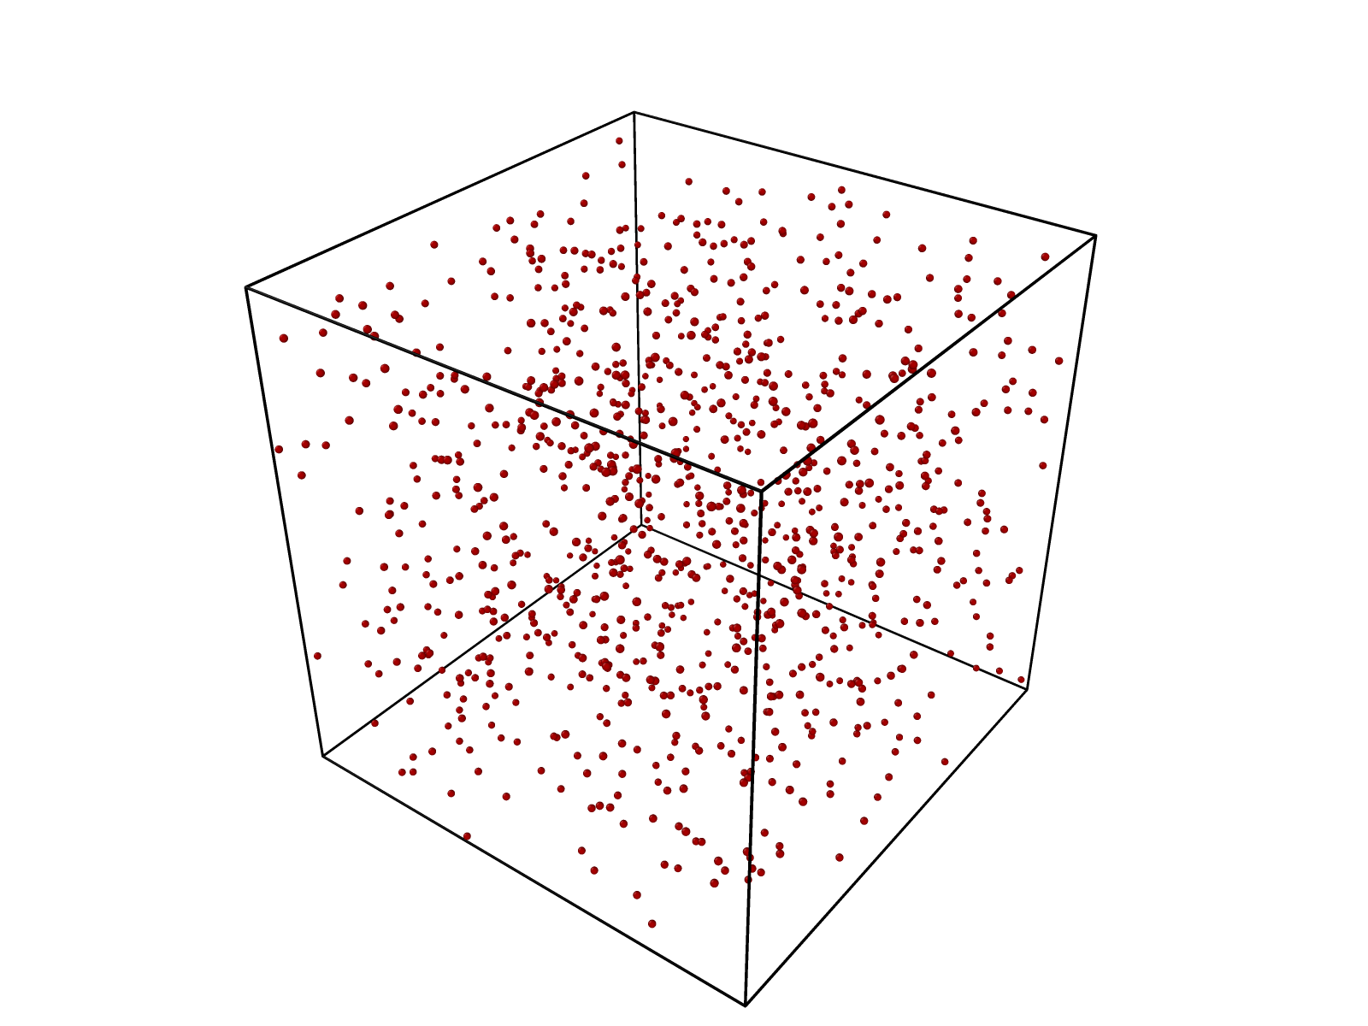
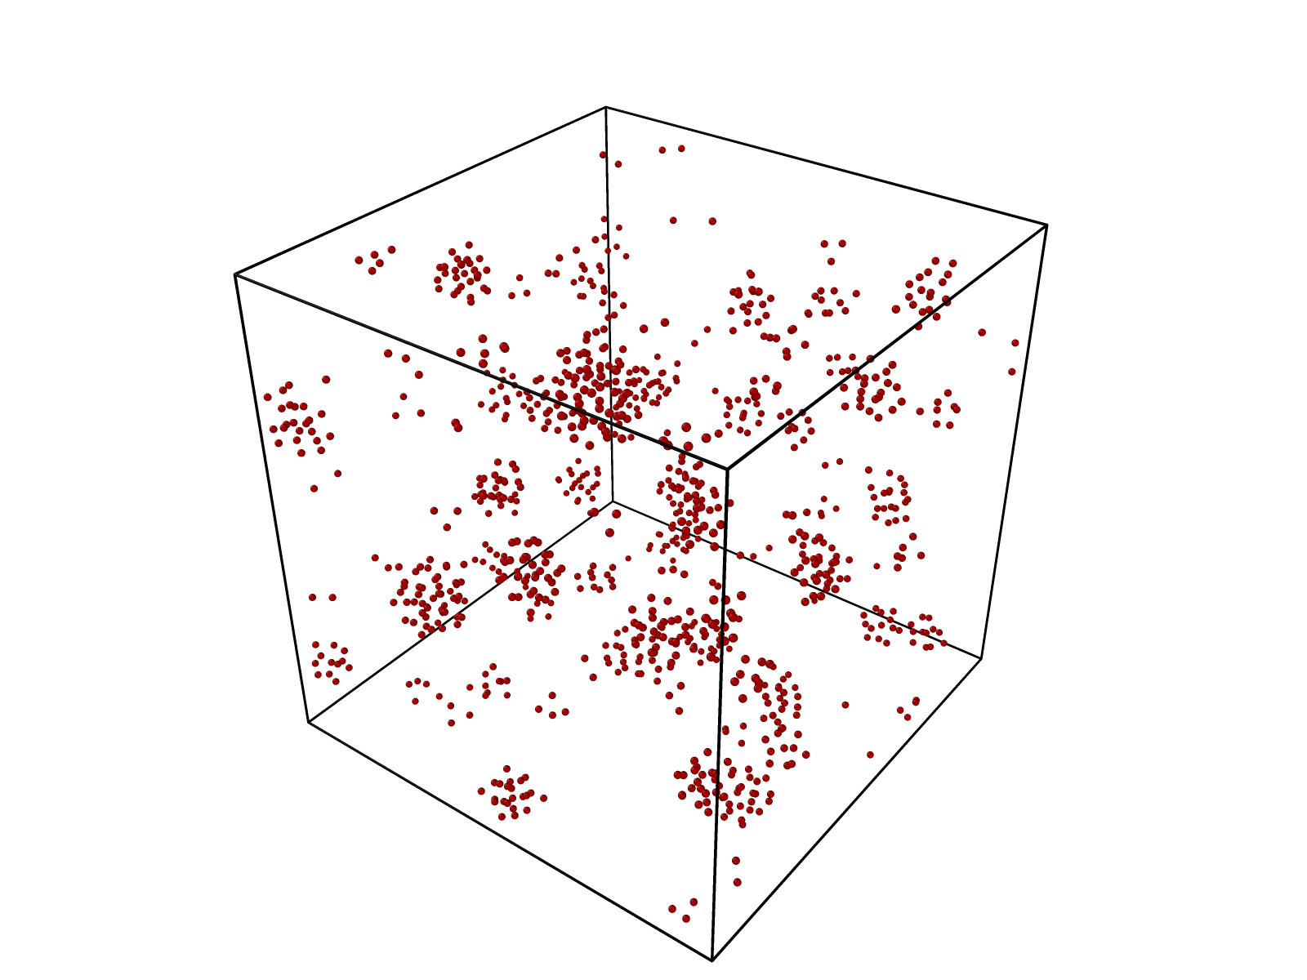
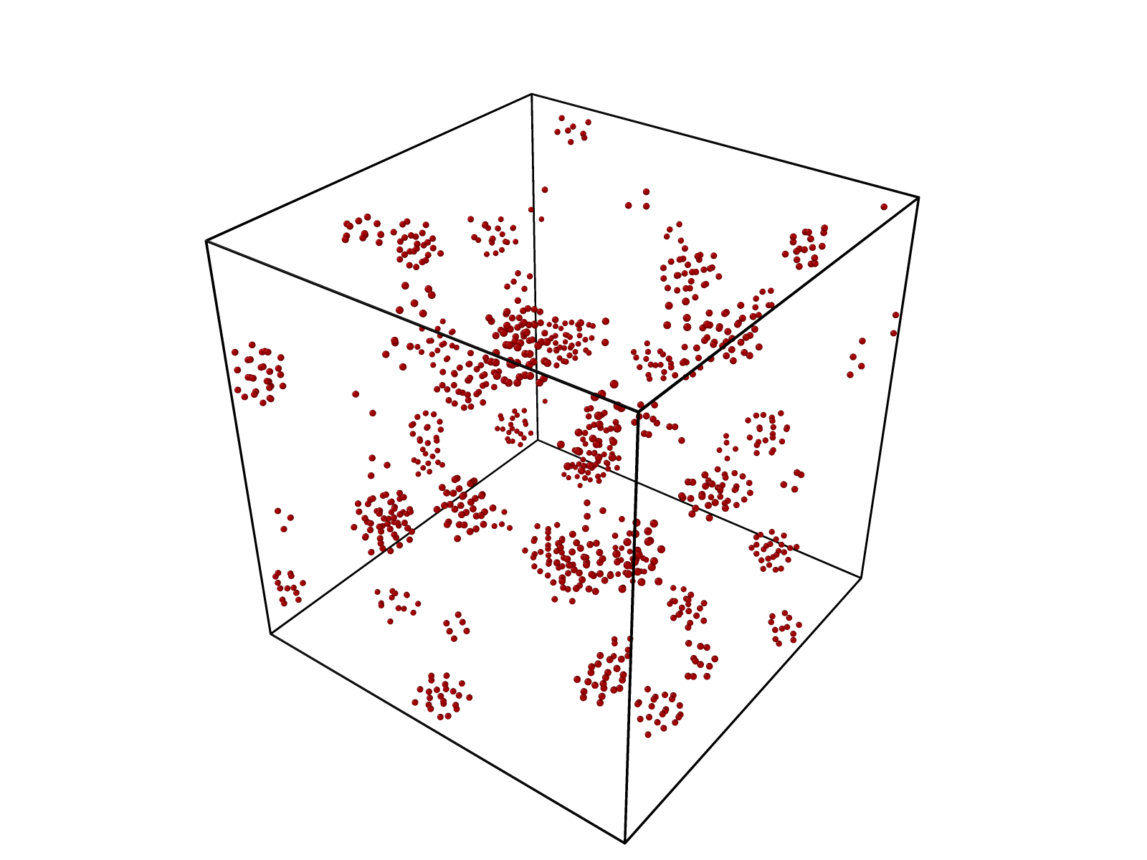
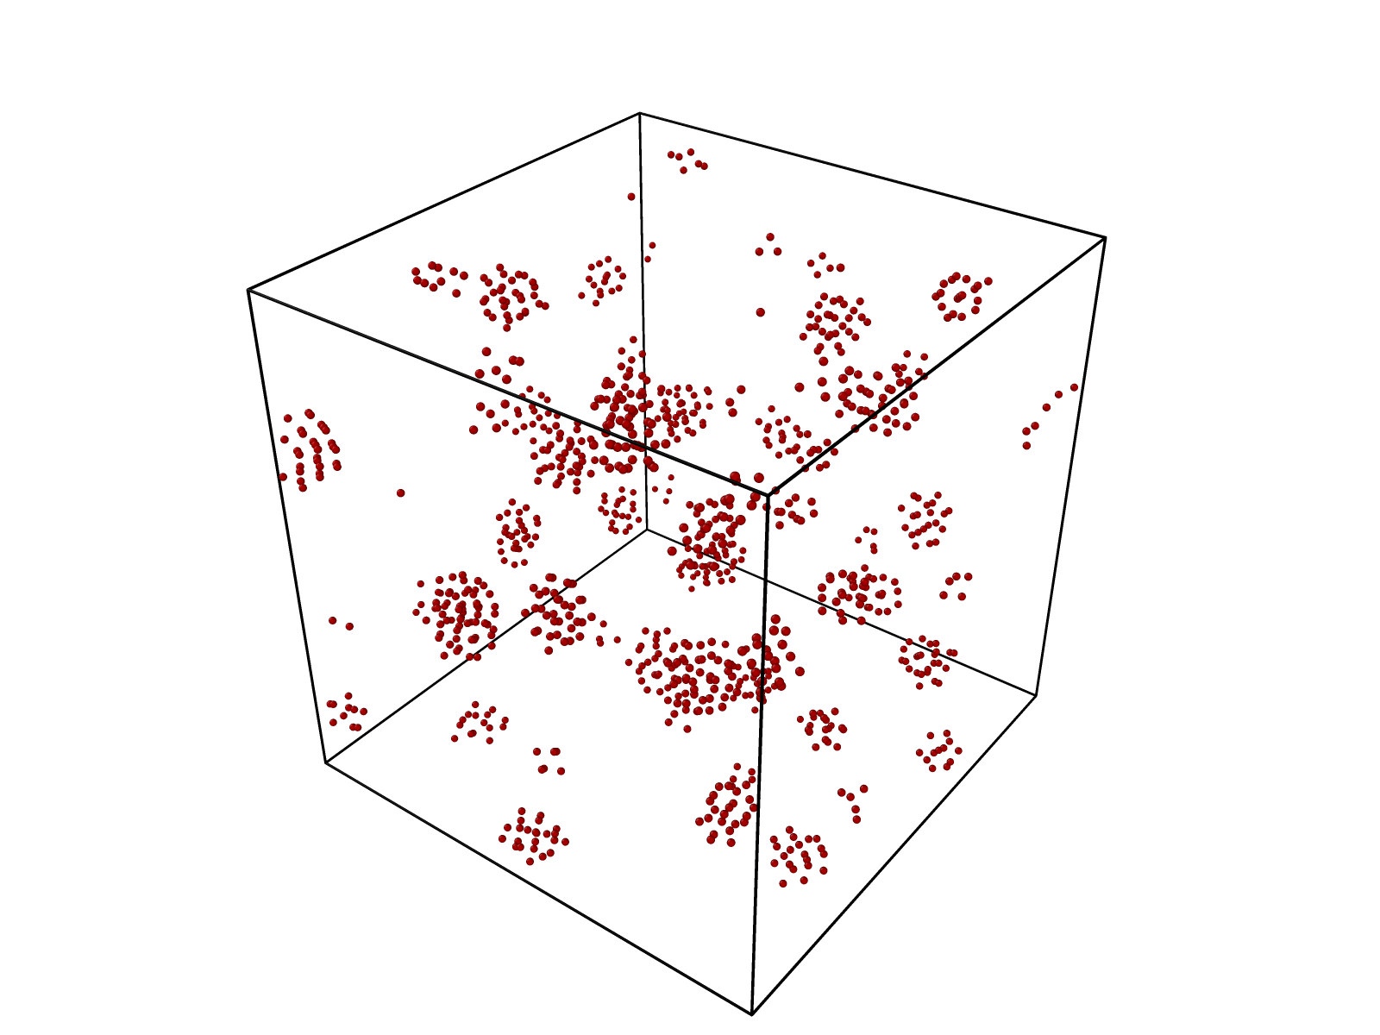
Results DLS
A.
B.
0 Mins
20 Mins
40 Mins
60 Mins
80 Mins

Slide 13
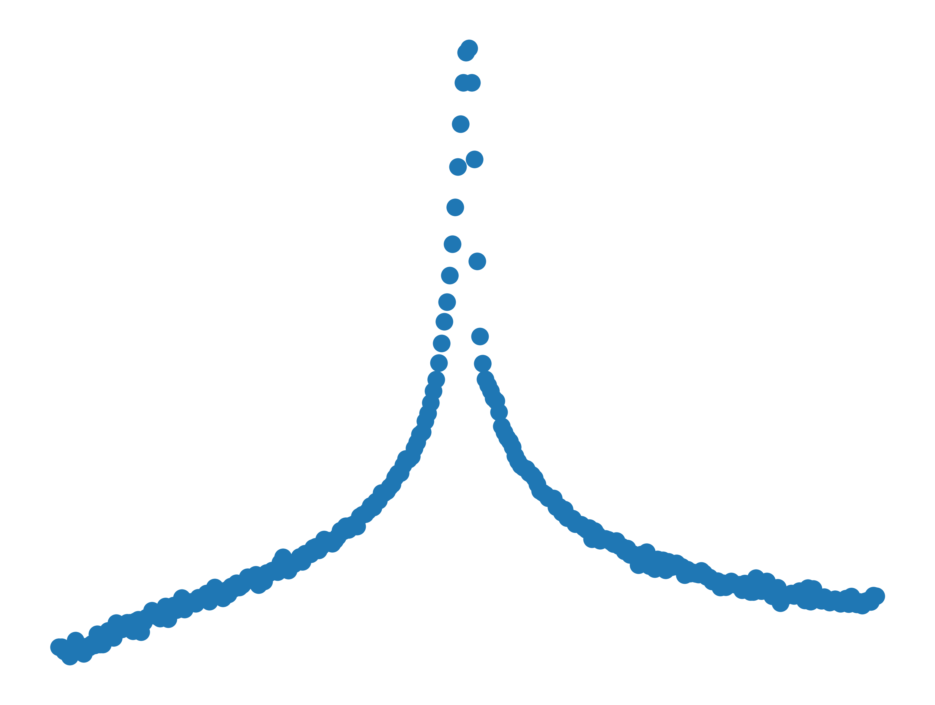
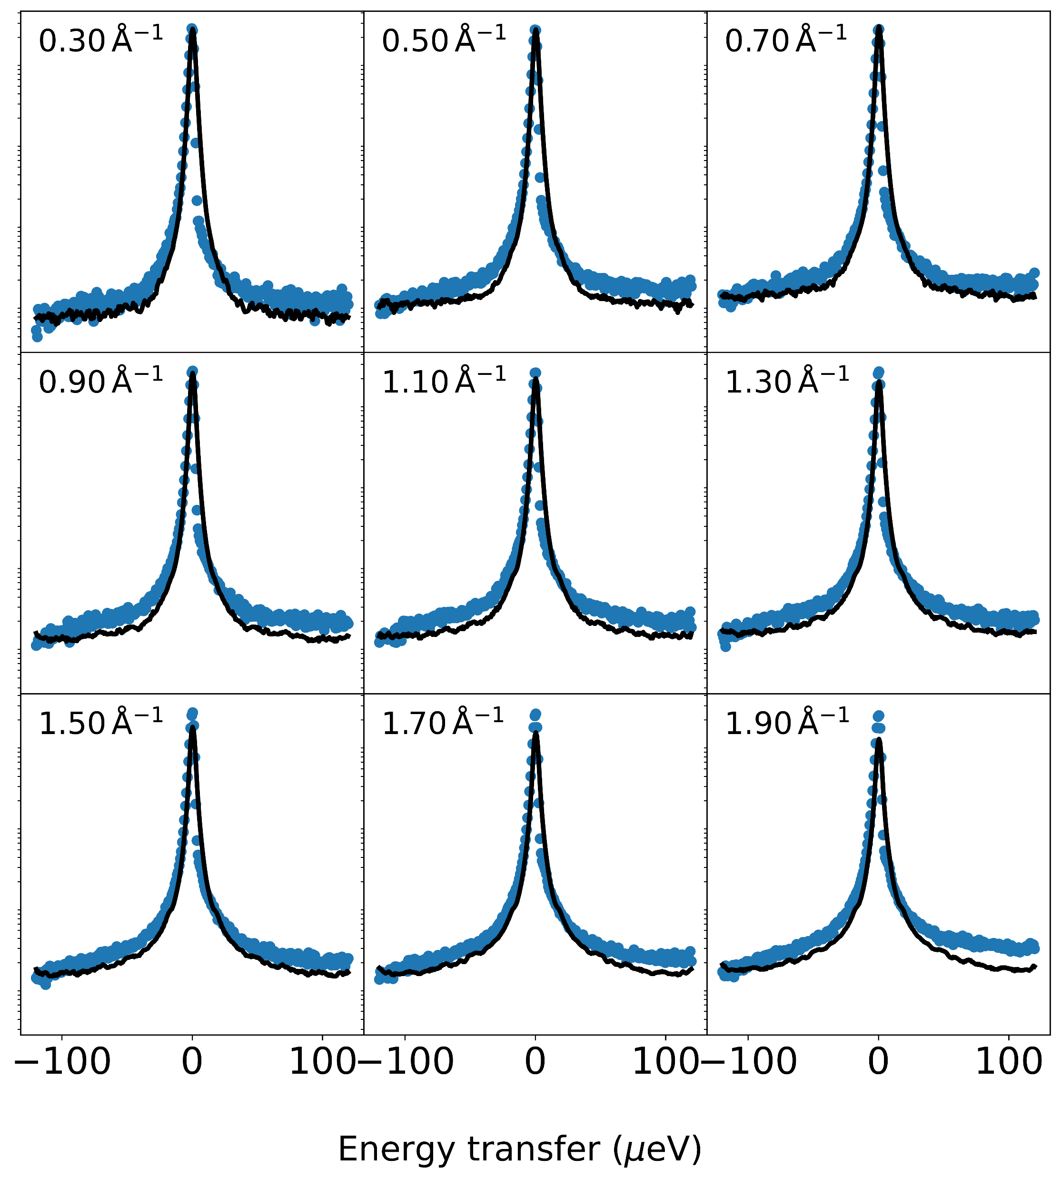
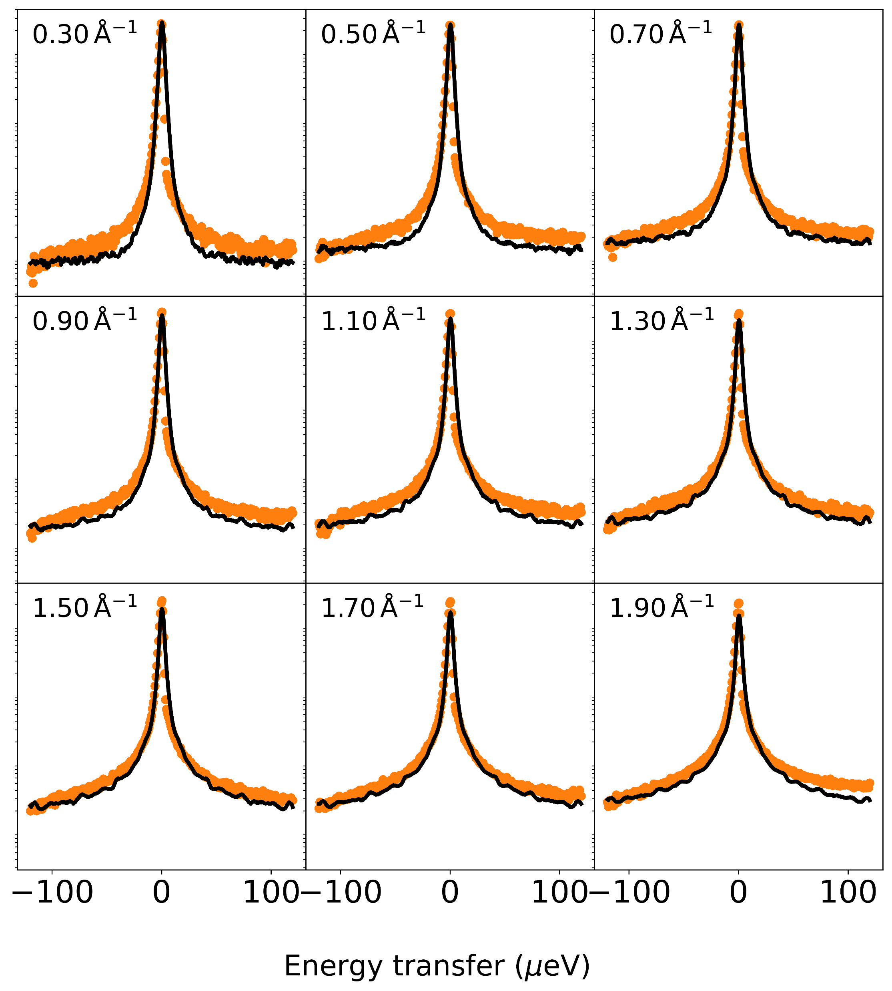
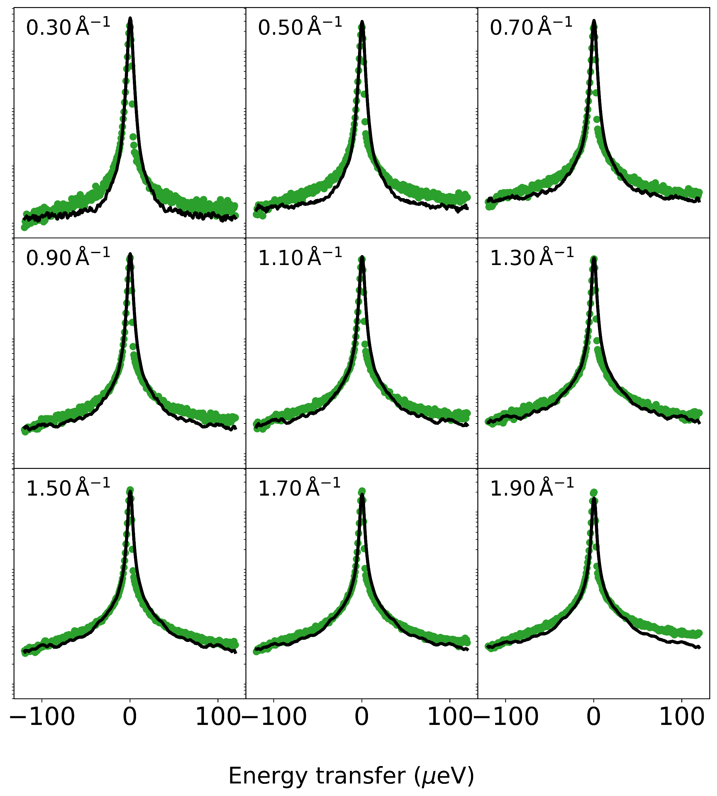
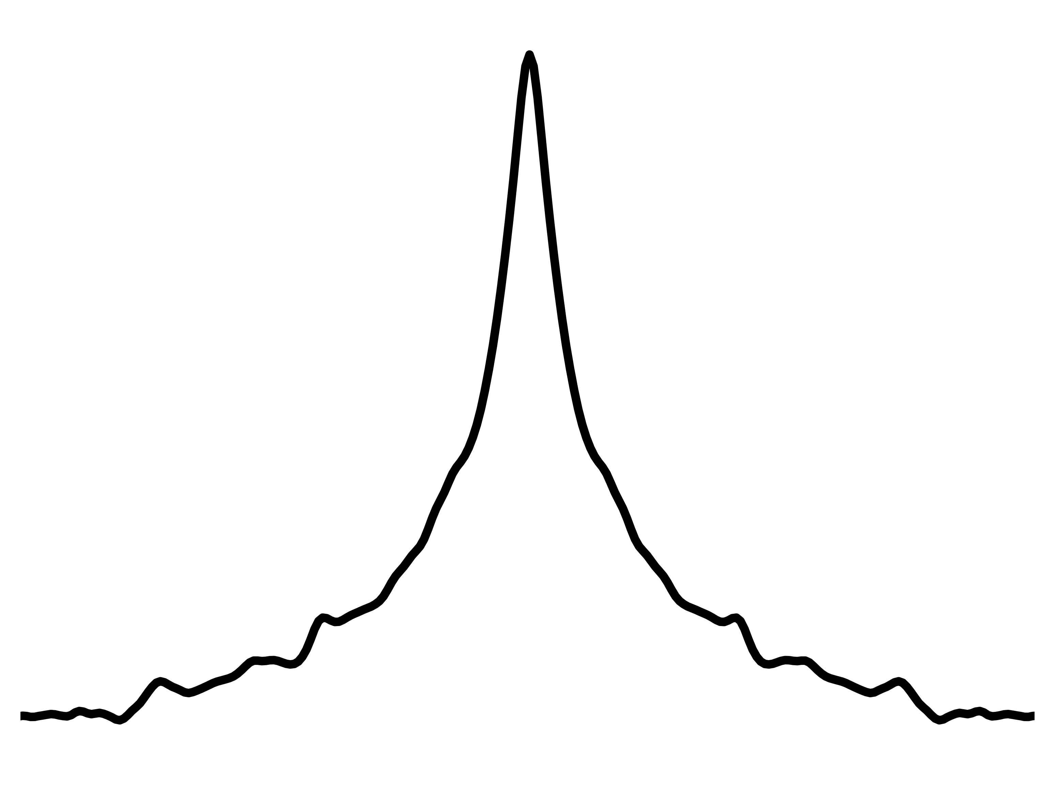
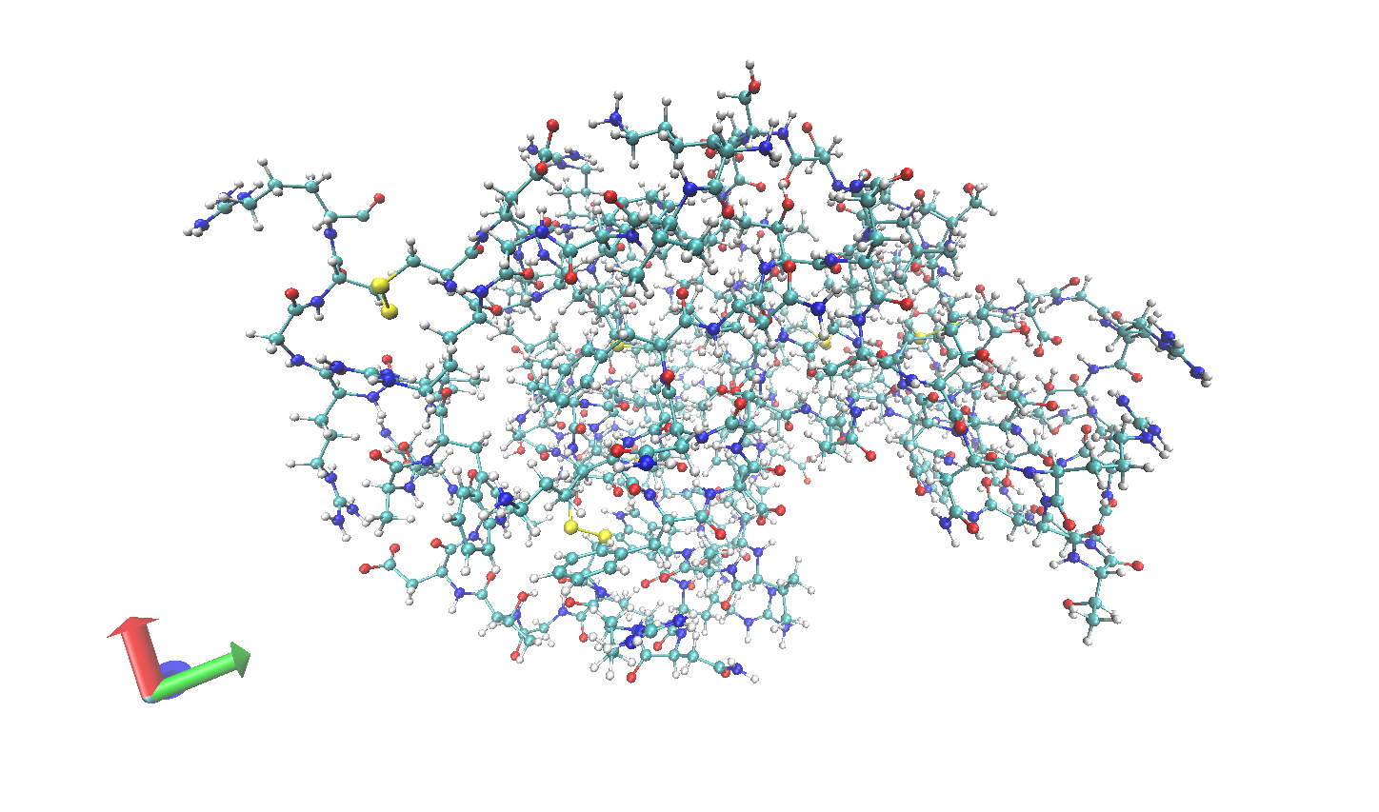


Experimental QENS of Lysozyme
Match Simulation to Experiment Using Series Alignment
T=230K
Neutrons
T=260K
Sample
T=290K
$$S(q, ω,T)$$
Simulated QENS of Lysozyme
$$S(q, ω,T)$$

Slide 14
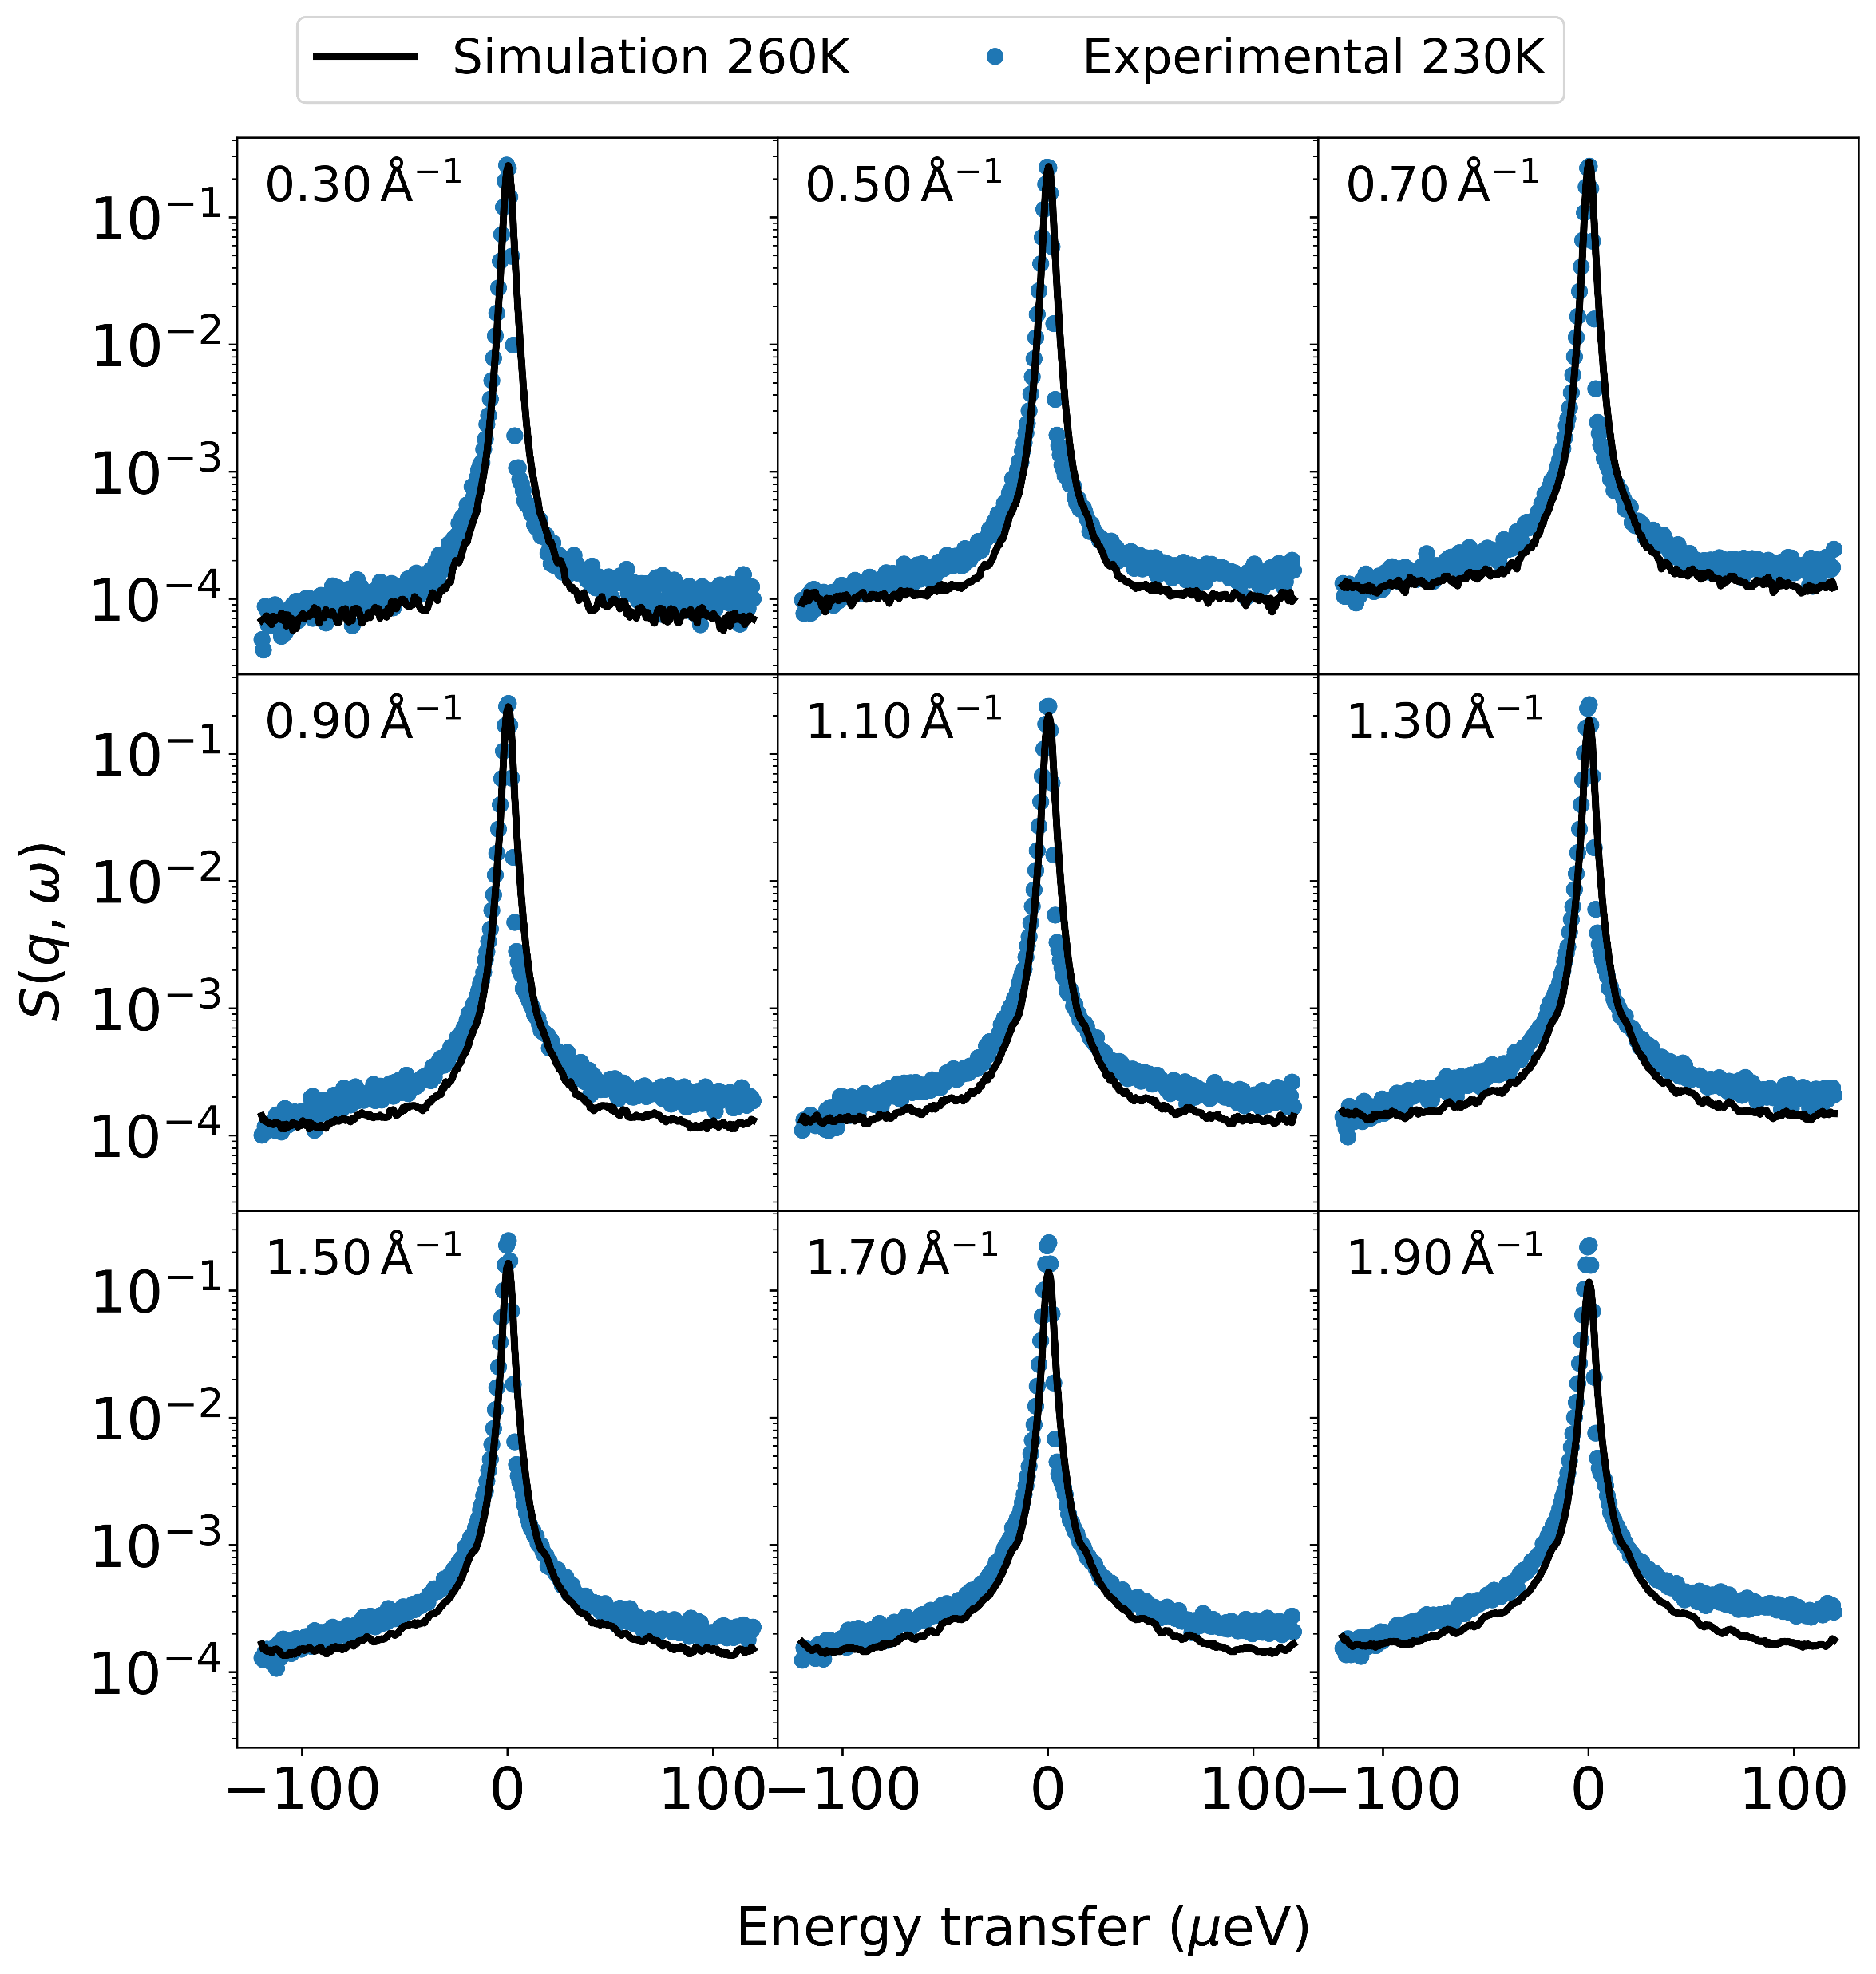
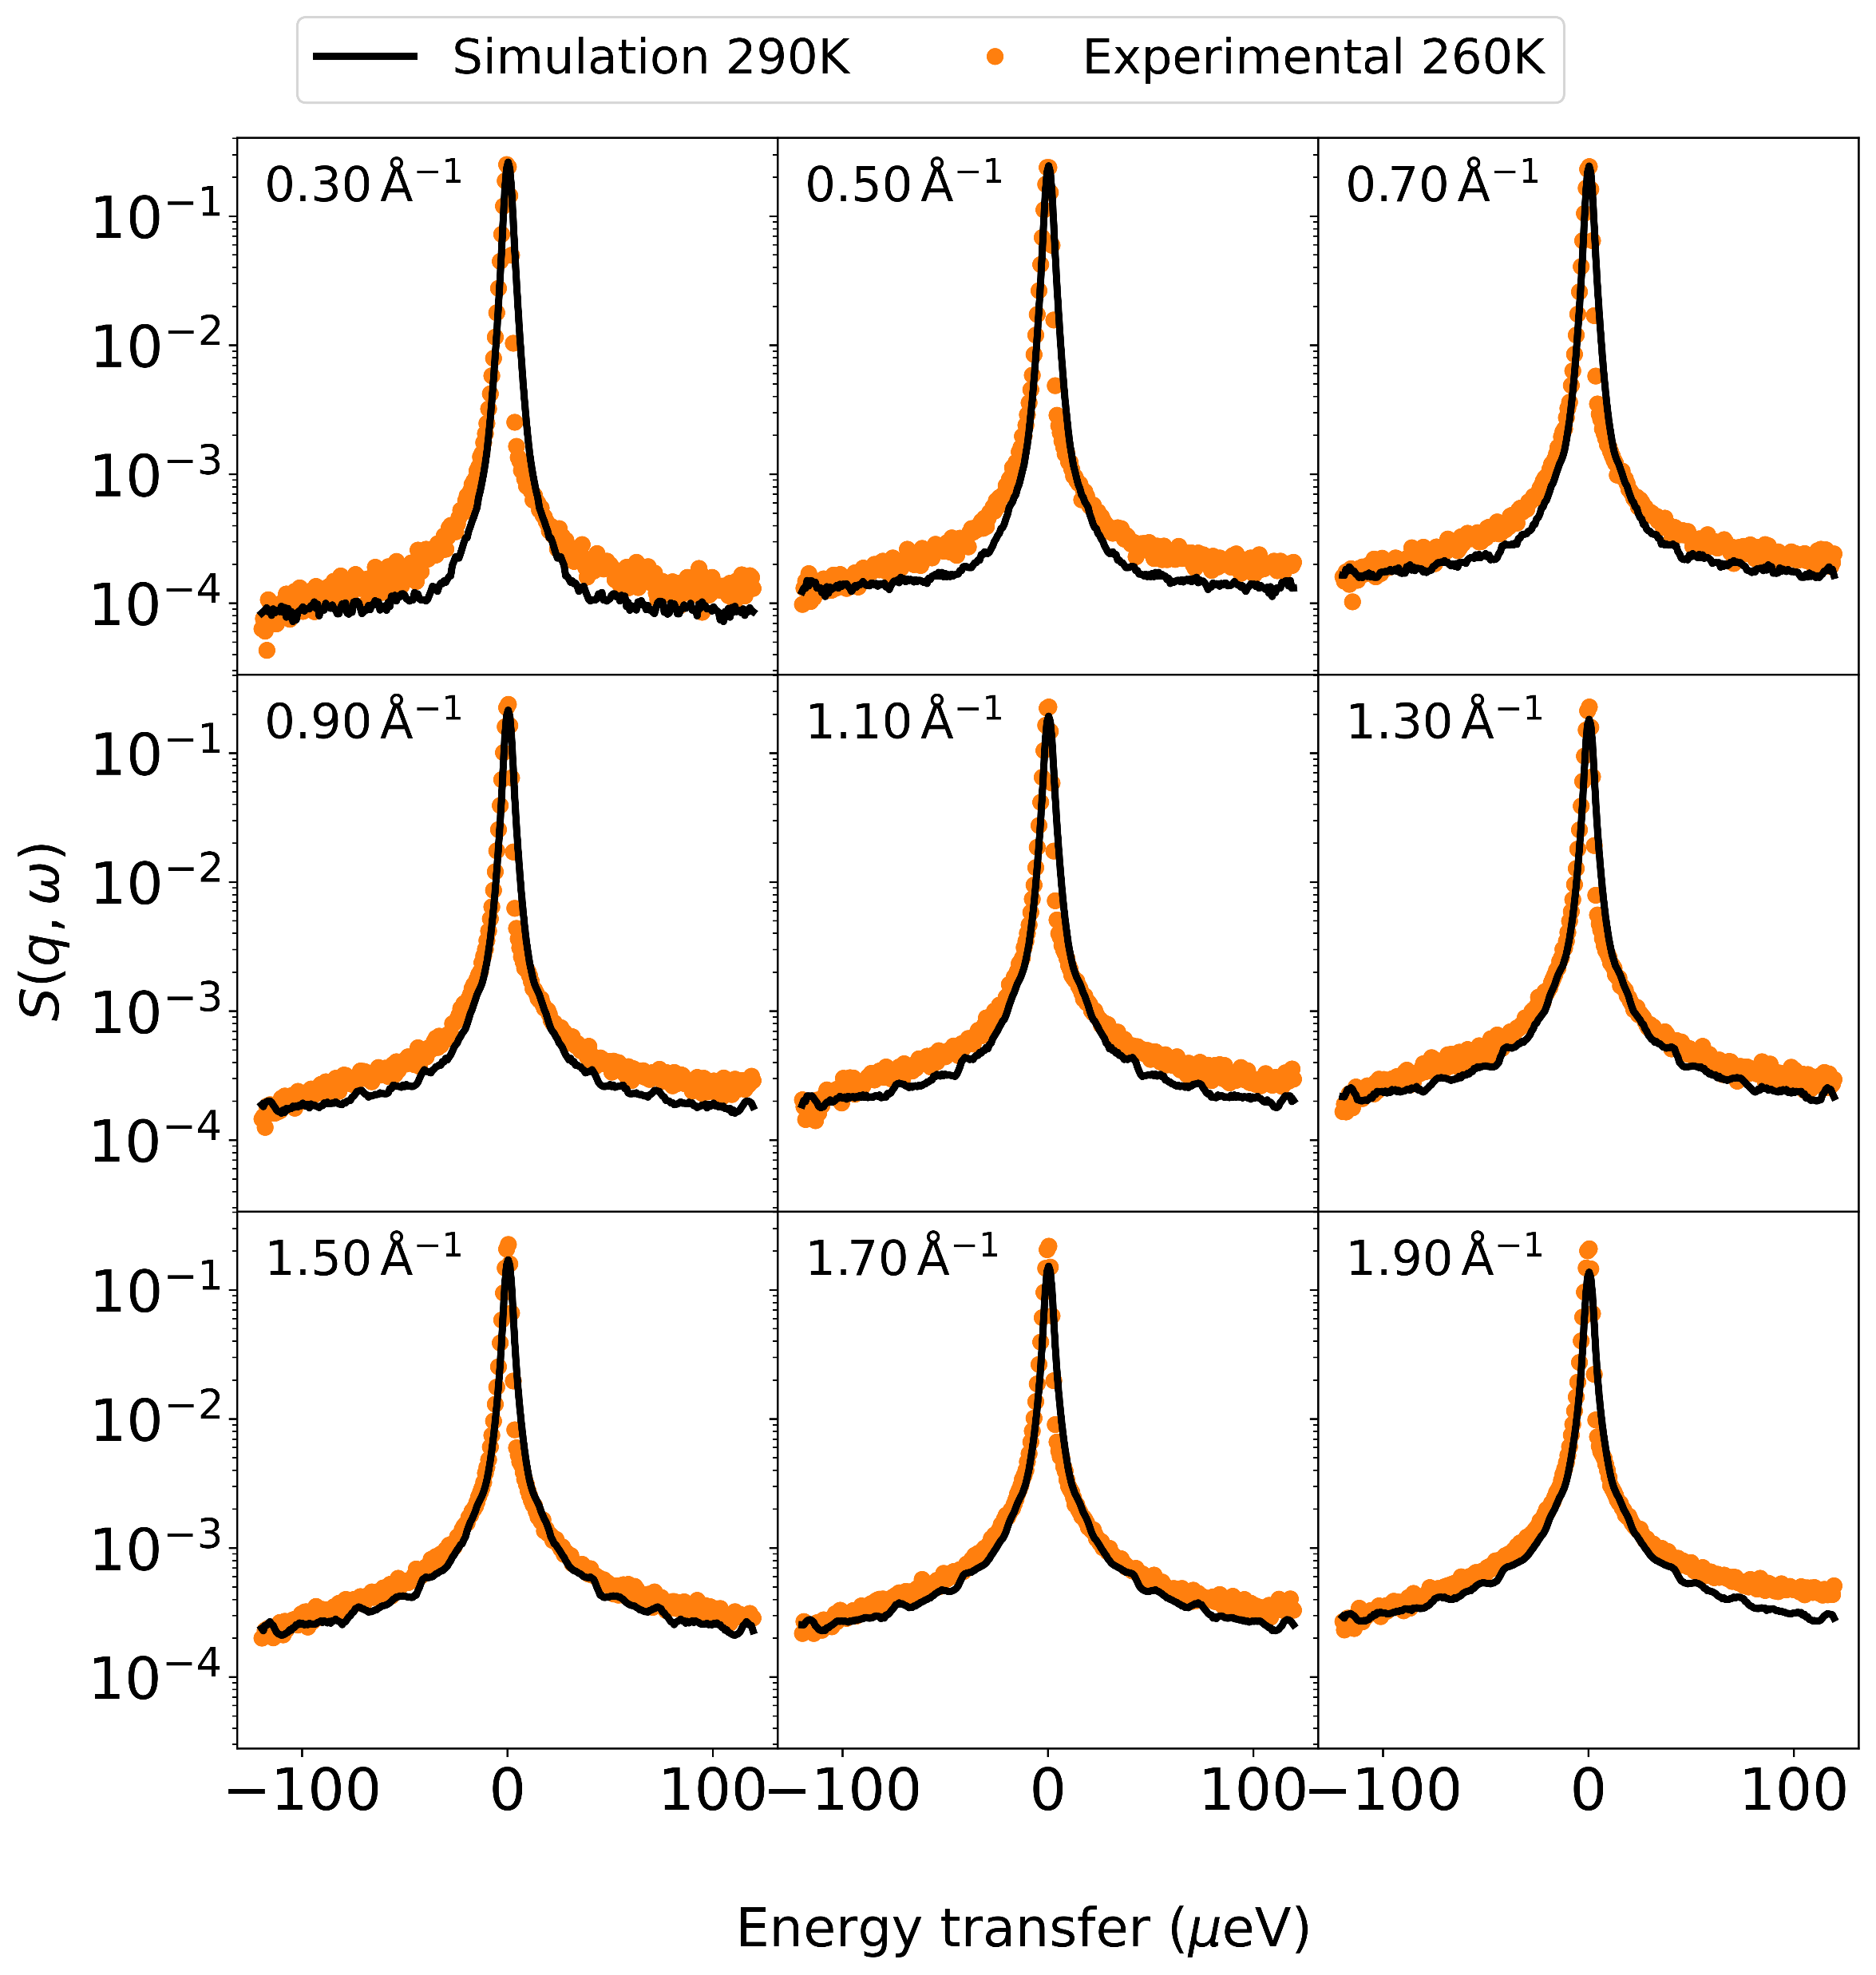
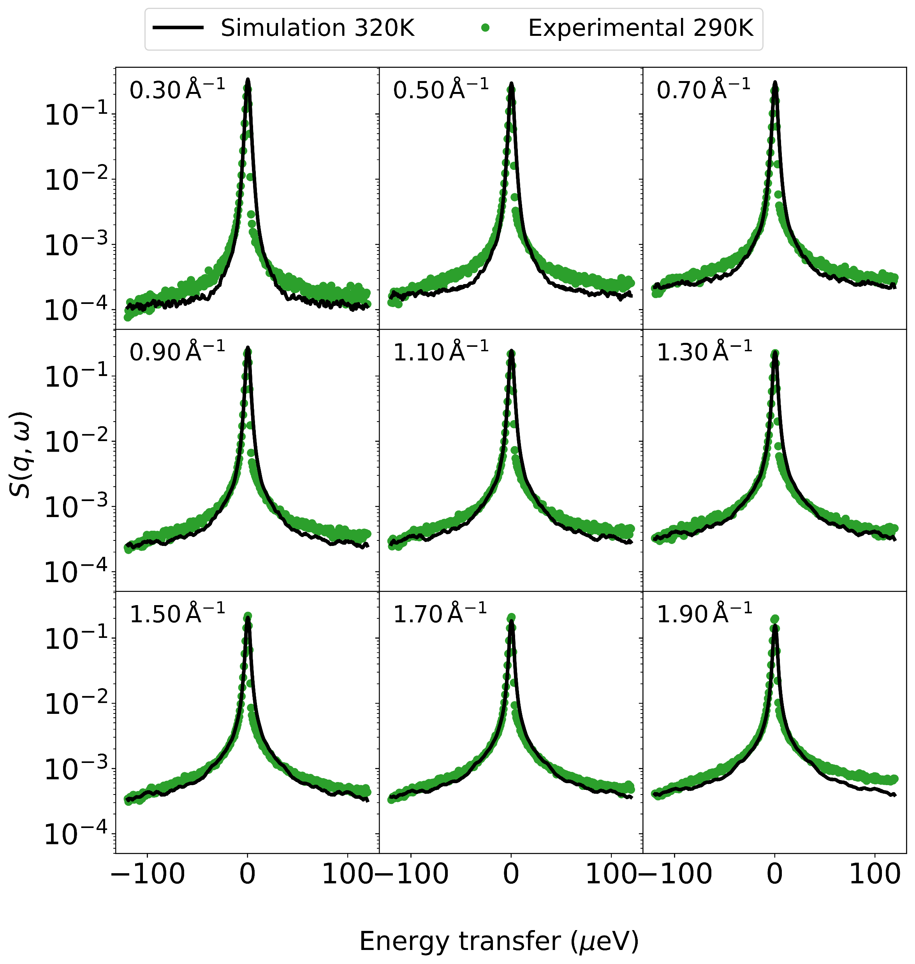
A.
B.
C.

Slide 15
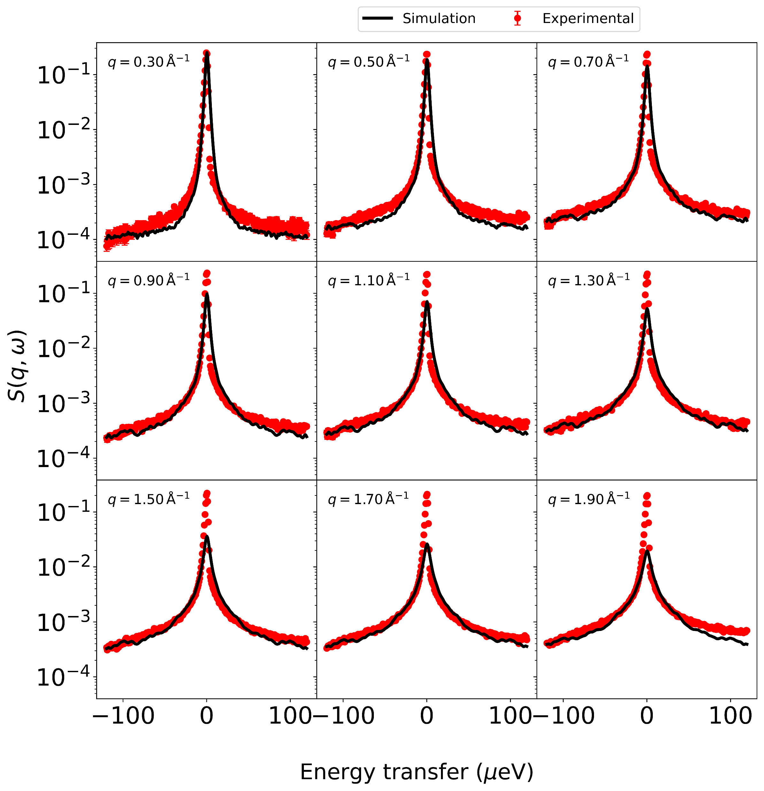

Slide 16
Experiment
Alignment
Simulation

Slide 17
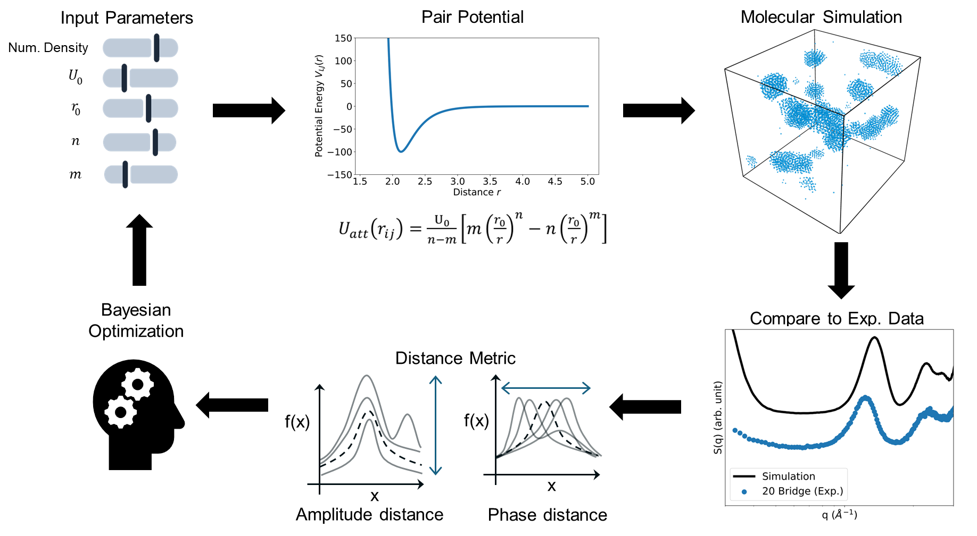
Applications
Compare Series Data
Refining Molecular Simulations

Slide 18
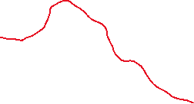
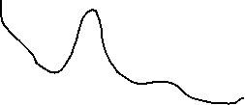
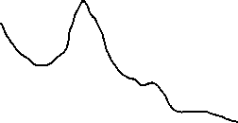

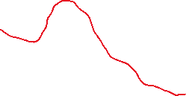

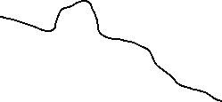

Applications
DBS Measurement on Polymer at different Temperatures
T = 42
T = 34
T = 29
DBS at Different Temperatures
Align Curves
Molecular Simulation of
Polymer at different Temperatures
T = 50
T = 40
T = 42
T = 30
T = 20
T = 34
T = 10
T = 29

Slide 19









Results SAXS
0 Mins
10 Mins
20 Mins
SAXS
30 Mins
40 Mins
50 Mins
60 Mins
70 Mins
80 Mins

Slide 20

Sample
X-ray

